Slide 1


Slide 2
Trainer Guidelines for Conducting Class
Solve questions live by creating new blank files (Excel, Python, Jupyter notebook, Dashboard) during the session, rather than sharing completed solutions.
Review teaching materials and solutions beforehand, and prepare additional examples to reinforce learning.
Ensure online students can hear you and see the screen clearly at all times.
Test your computer and necessary software before class begins.
Check with online students every 15-20 minutes to see if they understand the material and have any questions.

Slide 3

Agenda: Data Science Workflow - 1
Introduction
Data Collection
Exploratory Data Analysis (EDA) And Visualization
Data Preprocessing
Machine Learning Model Development
Model Deployment

Slide 4
Introduction
Brief Overview of the Session:
This session is an immersive journey into an end-to-end data science project.
We will explore the entire data science workflow from data collection to model deployment.
Importance of End-to-End Data Science:
Understanding the complete data science process is essential for real-world applications.
It mimics the way data science projects are conducted in industry, from raw data to actionable insights.

Slide 5
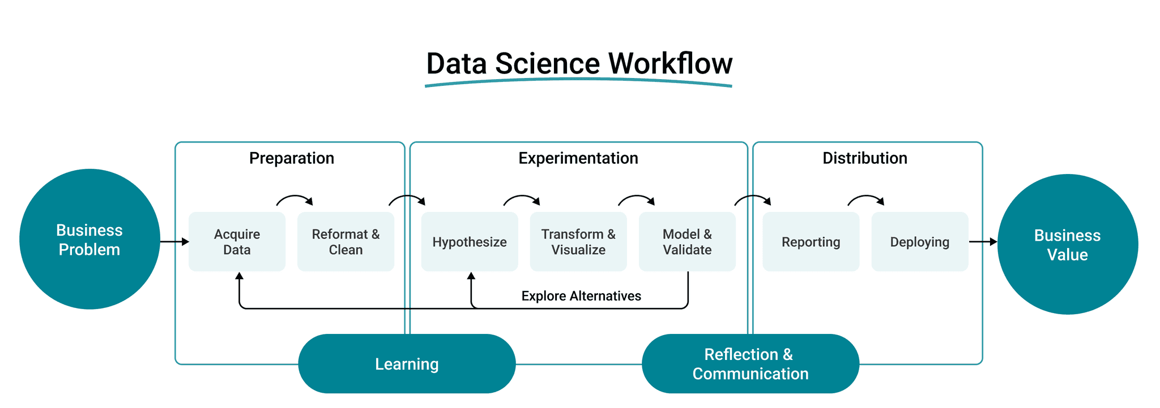
Introduction

Slide 6
Telecom Customer Churn Analysis and Predictive Modeling
Introduction
In today's competitive market, retaining customers is crucial for the success of any business, especially in the telecommunications industry.
This case study explores the analysis of customer churn for a subscription-based telecom service provider and aims to develop predictive models to identify potential churners.
The dataset used includes customer information such as contract details, services used, and churn status.

Slide 7
Telecom Customer Churn Analysis and Predictive Modeling
Objective
The primary objective is to understand the factors influencing customer churn and build machine learning models to predict churn.
By doing so, the telecom company can proactively implement retention strategies, thereby reducing customer attrition and improving overall business performance.

Slide 8
Data Collection
Data collection in data science is the process of gathering data from various sources. It involves identifying sources, gathering data, and storing it in a structured format.
Clean, high-quality data is essential for accurate analysis and modeling.
Dataset: Customer Churn Prediction Dataset.
Content: Contains customer data for churn prediction.
Source: Sourced from a telecommunications company.
Purpose: Used for real-world customer churn analysis.

Slide 9
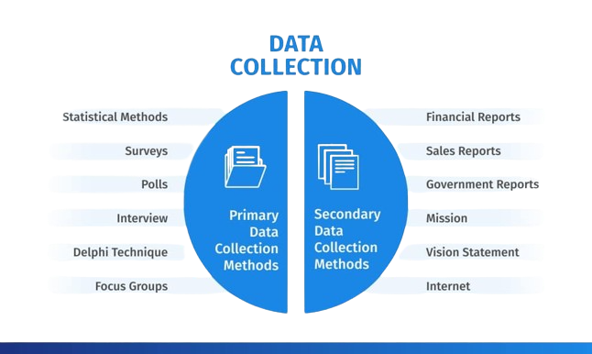
Data Collection

Slide 10
Data Collection
Dataset: Telecom Churn Prediction Dataset (Telco_Customer_Churn.csv)
Description: Contains customer information for a subscription-based service provider to predict customer churn (leaving the service).
Columns: Includes customer details, services used, contract terms, and churn status.
Purpose: Used for customer churn analysis, segmentation, and retention strategies.
Applications: Churn prediction, customer satisfaction analysis, and targeted marketing.
Analysis Tasks: EDA, data preprocessing, ML model building, evaluation, and model deployment.

Slide 11
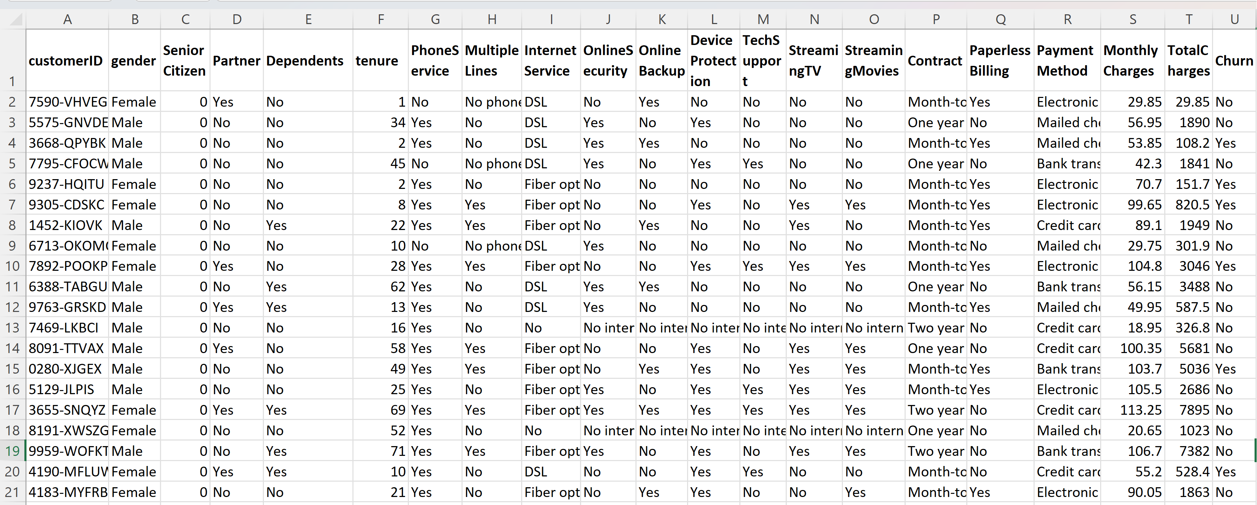
Data Collection

Slide 12
Data Preprocessing
Handling Missing Values
Discuss strategies for addressing missing data, such as imputation or removal.
Dealing with Outliers
Identify and address outliers that can impact model performance.
Encoding Categorical Variables
Explain techniques to convert categorical data into a format suitable for machine learning models.
Splitting Data into Training and Testing Sets
Emphasize the importance of dividing data for model training and evaluation.

Slide 13
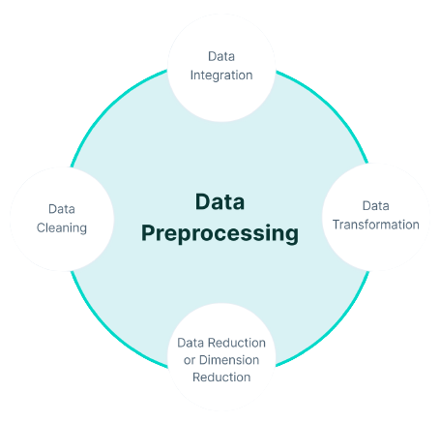
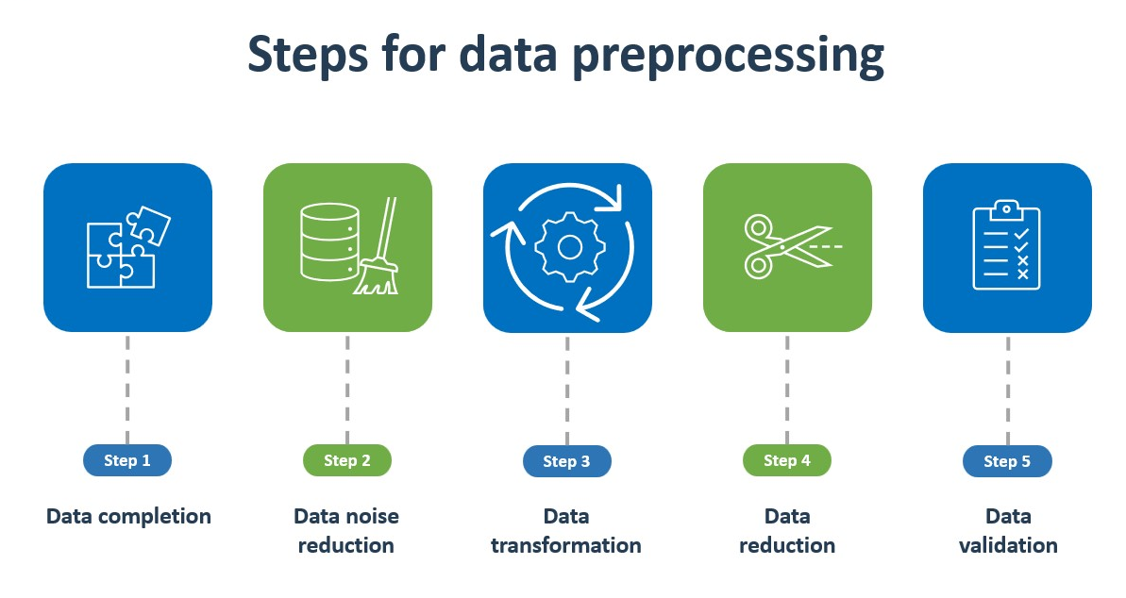
Data Preprocessing

Slide 14
Data Preprocessing
Explored demographic information, contract details, and services used by customers.
Investigated the distribution of gender, seniority, partner, and dependent status among customers.
Analyzed customer tenure, contract types, and the distribution of services used.
Key Insights:
The dataset includes a diverse customer base, with almost equal distribution between male and female customers.
Senior citizens constitute around 16% of the customer base.
Approximately 50% of customers have a partner, while only 30% have dependents.
Most customers opt for month-to-month contracts, indicating flexibility in service usage.
Customers with longer tenure tend to have two-year contracts.

Slide 15
Exploratory Data Analysis (EDA)
What is EDA?
EDA is the initial phase of data analysis.
It's about examining and understanding your data before diving into modeling.
Basic Statistics
Utilize basic statistics to summarize data.
Key stats include mean, median, and standard deviation.
Data Summary
Summarize the main characteristics of the data.
Identify patterns, anomalies, and insights.
Importance of EDA
EDA helps identify data trends, issues, and outliers.
It guides data preprocessing and feature selection.
A crucial step before building predictive models.

Slide 16
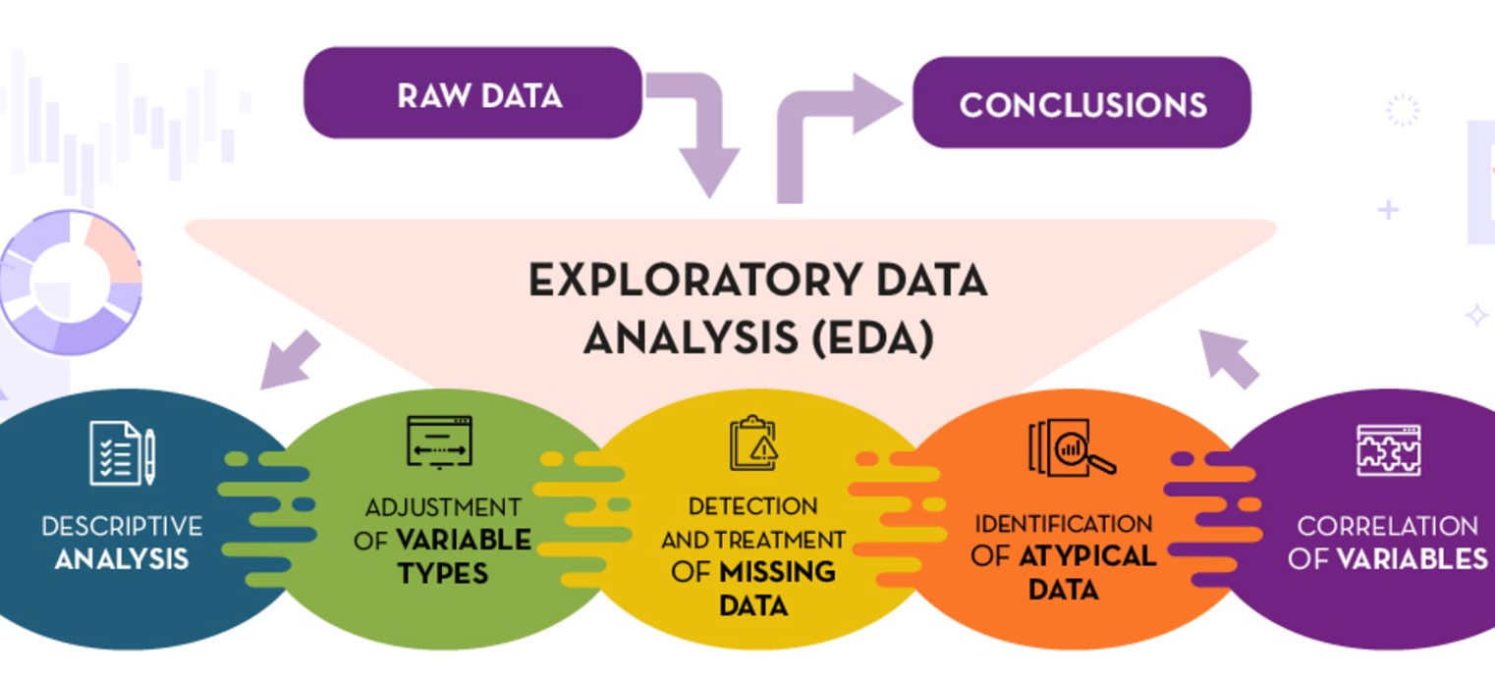
Exploratory Data Analysis (EDA)

Slide 17
Exploratory Data Analysis (EDA)
EDA - Data Visualization:
Types of Visualizations: Use histograms, scatter plots, etc., to understand data patterns.
Live Demonstration: Show how to create visualizations with Python (Pandas, Matplotlib, Seaborn).
Interpreting Visualizations: Learn to extract insights from visual data.

Slide 18
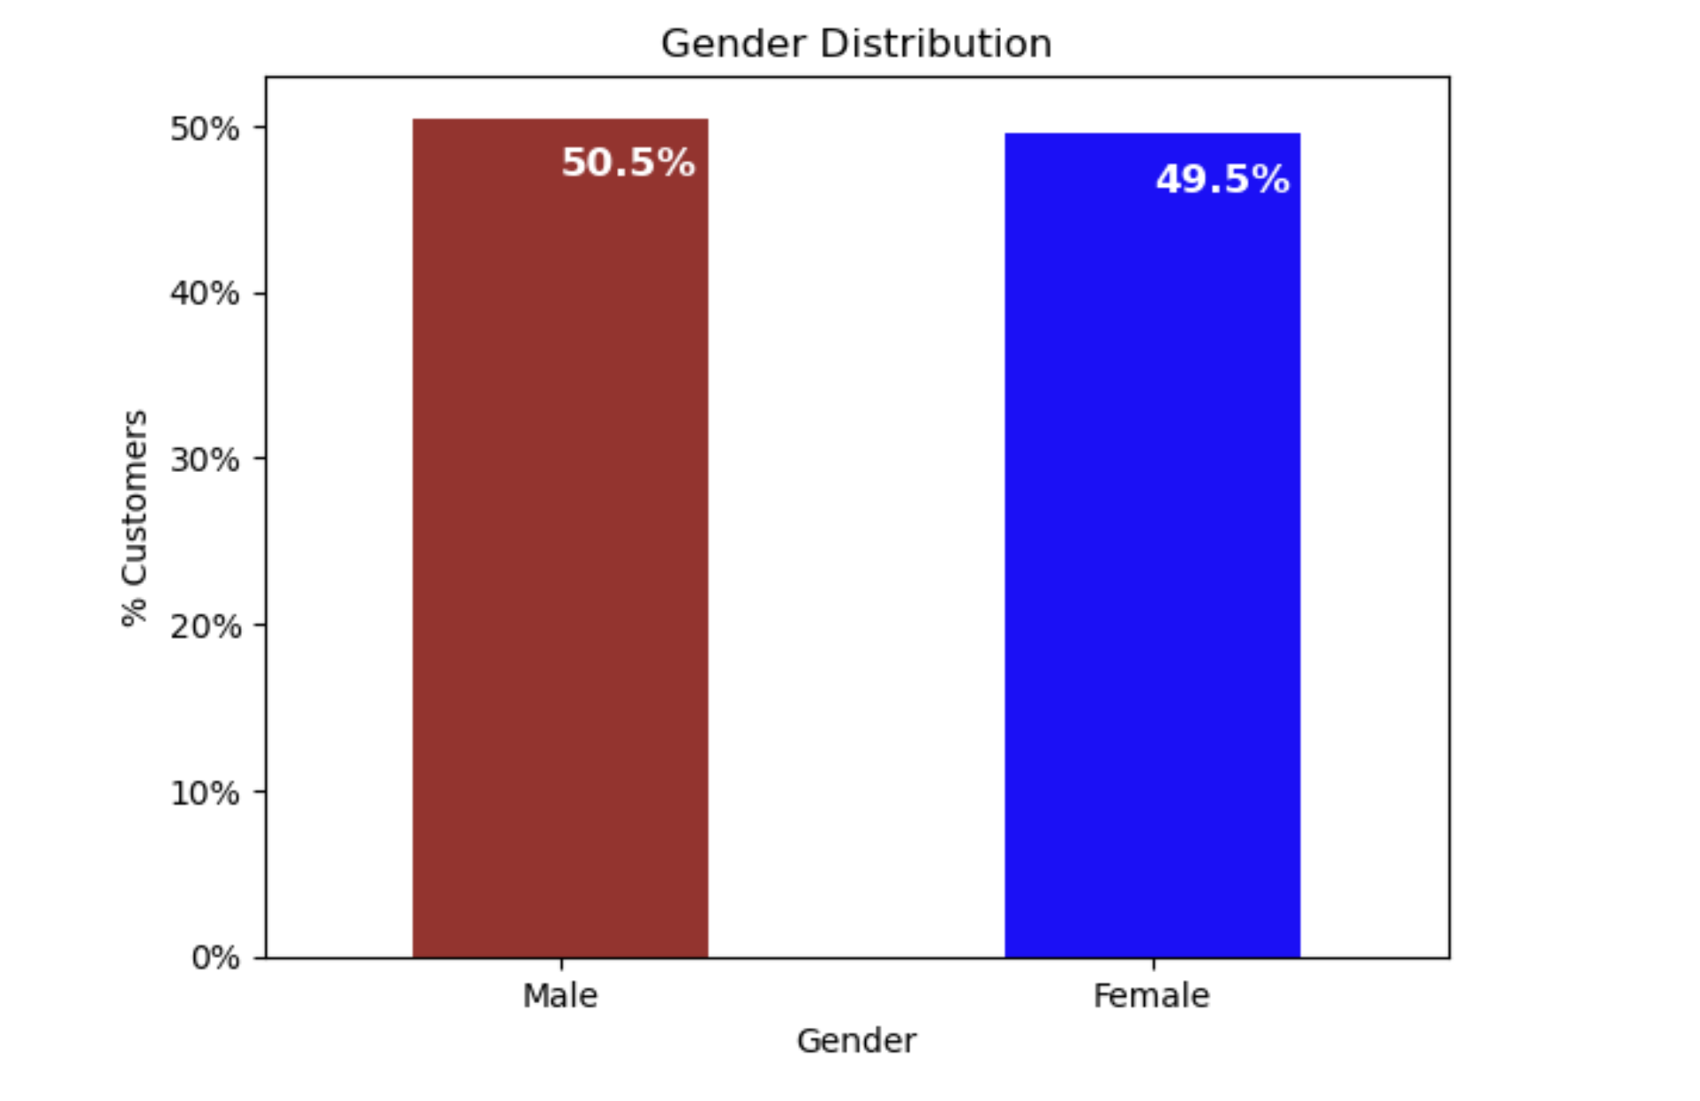
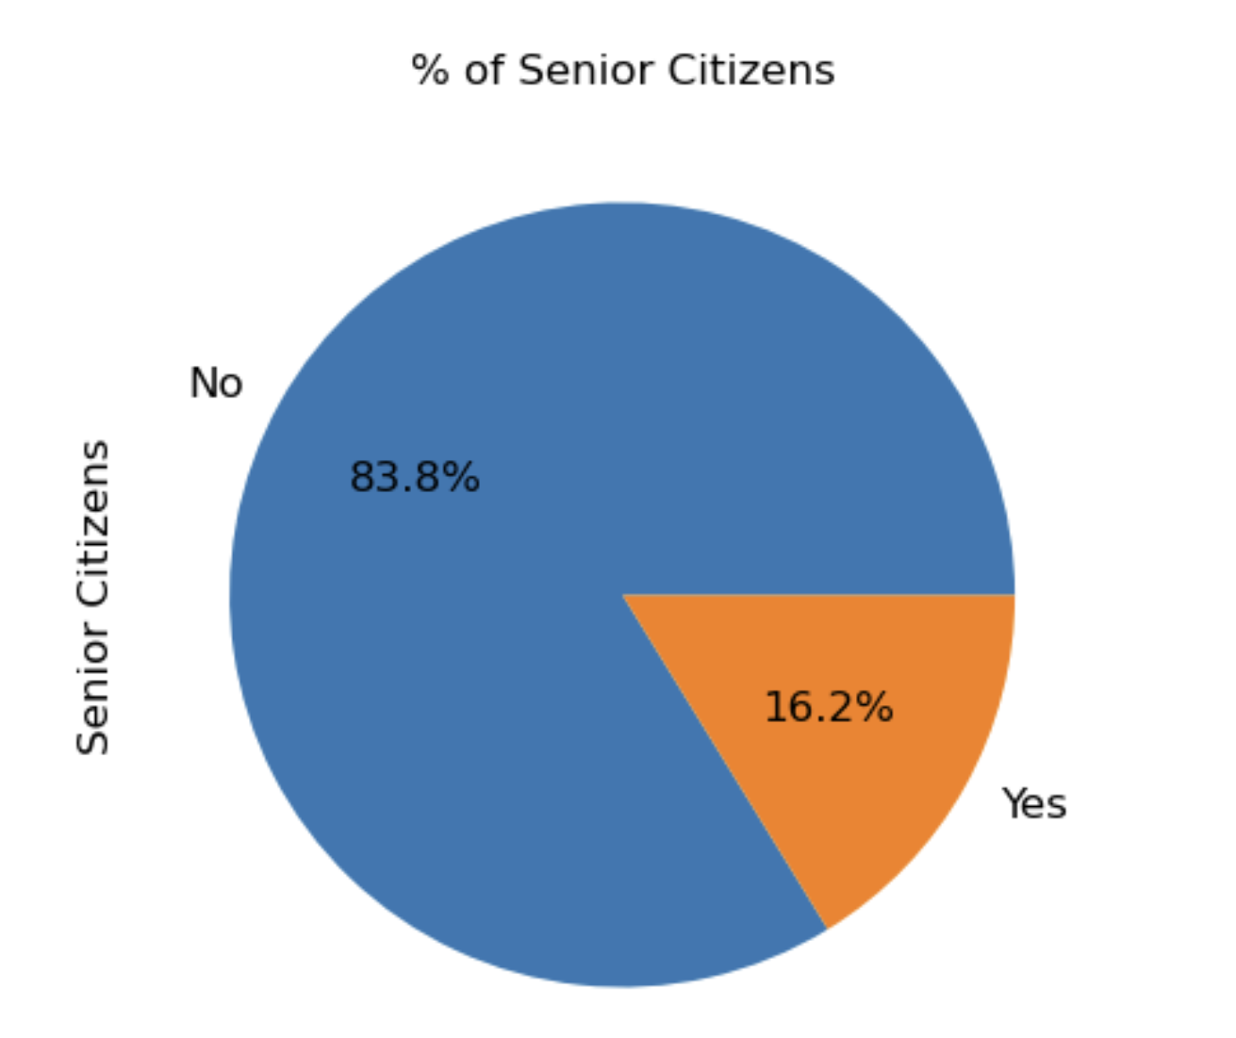
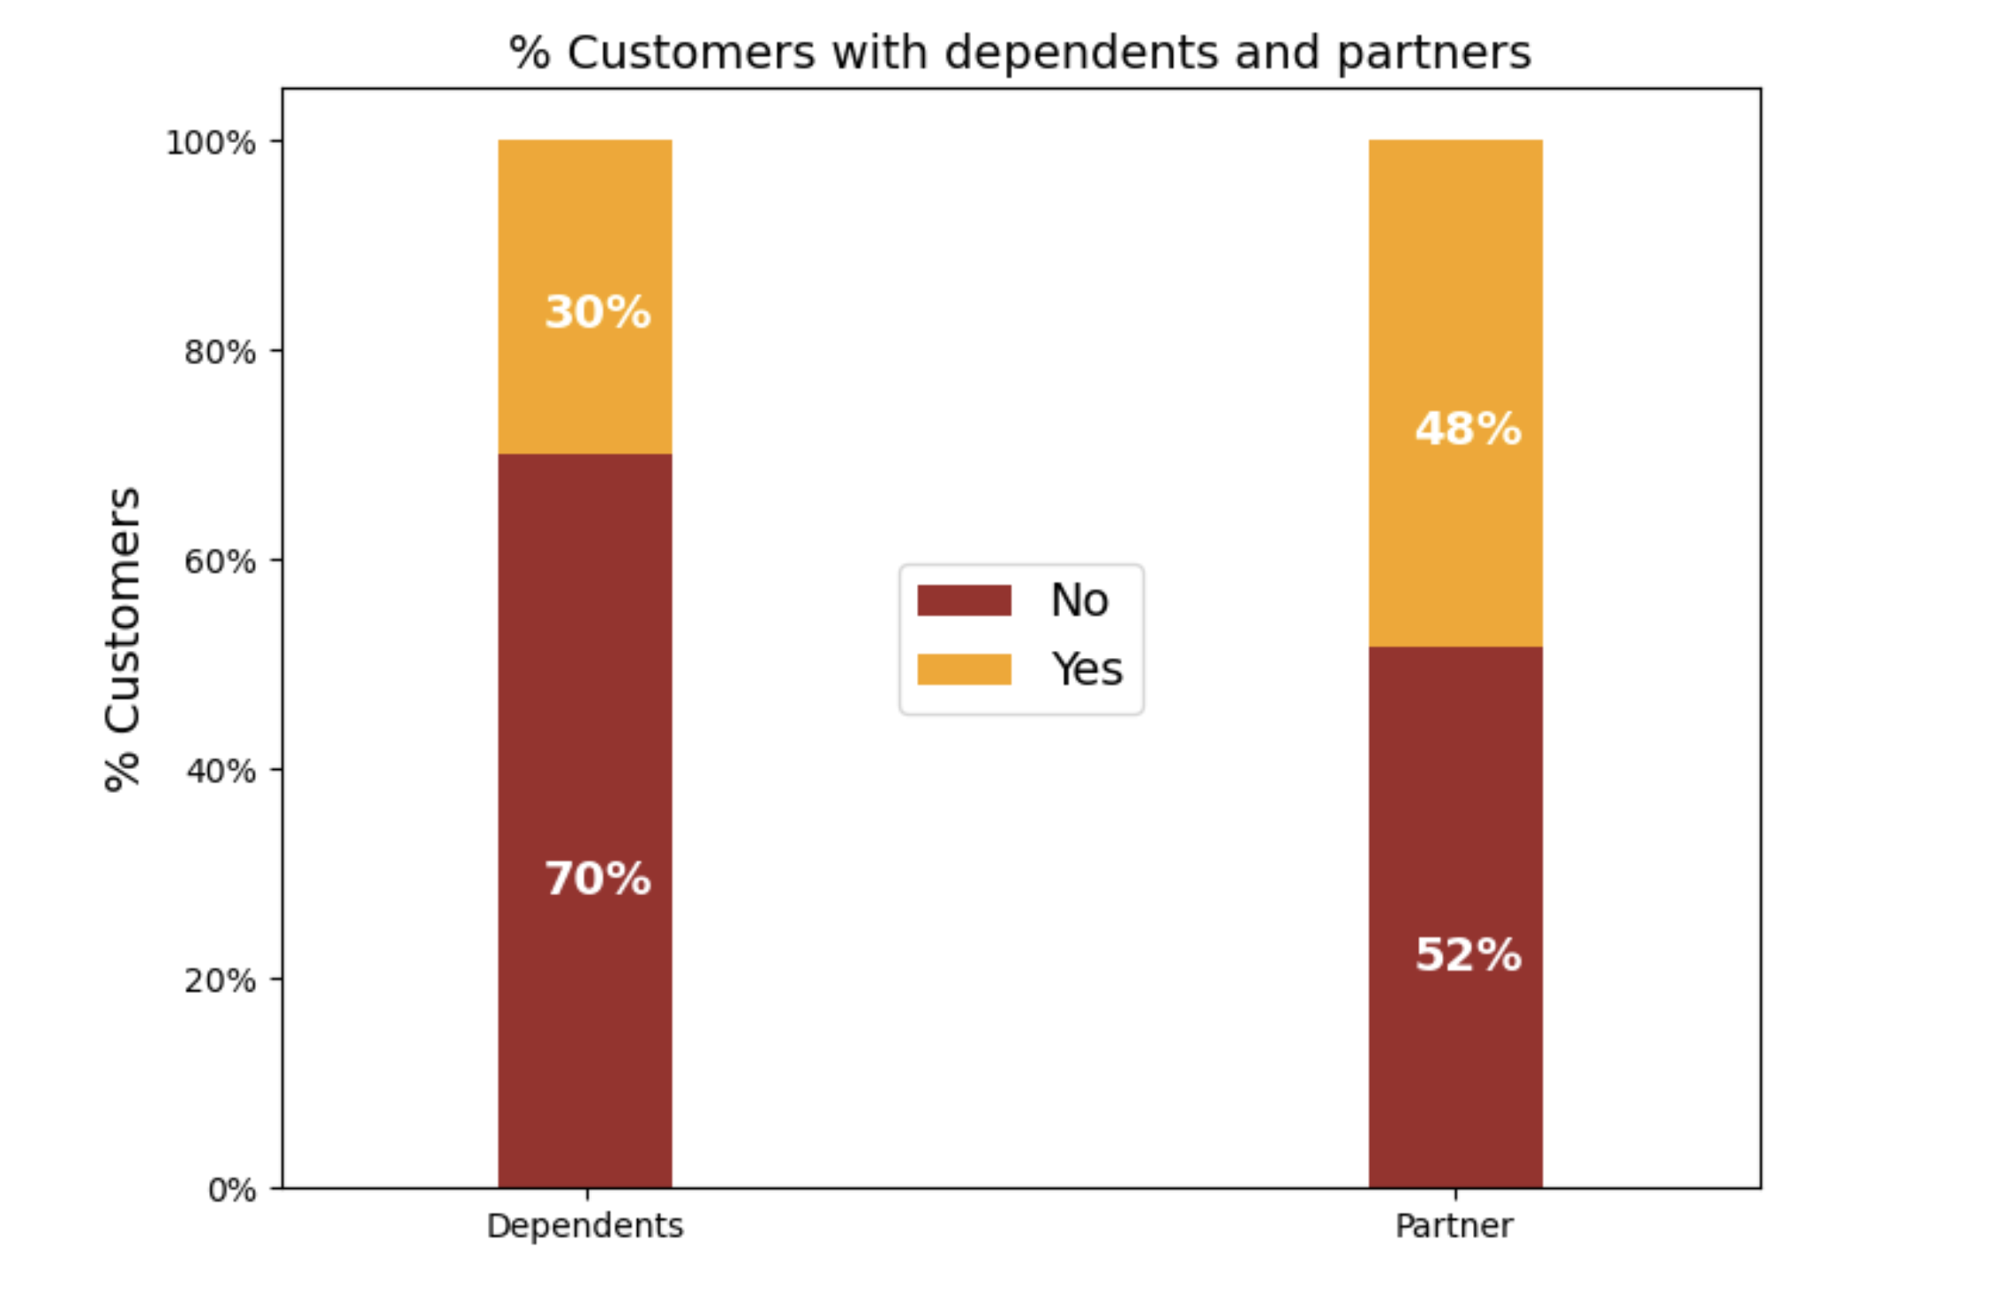
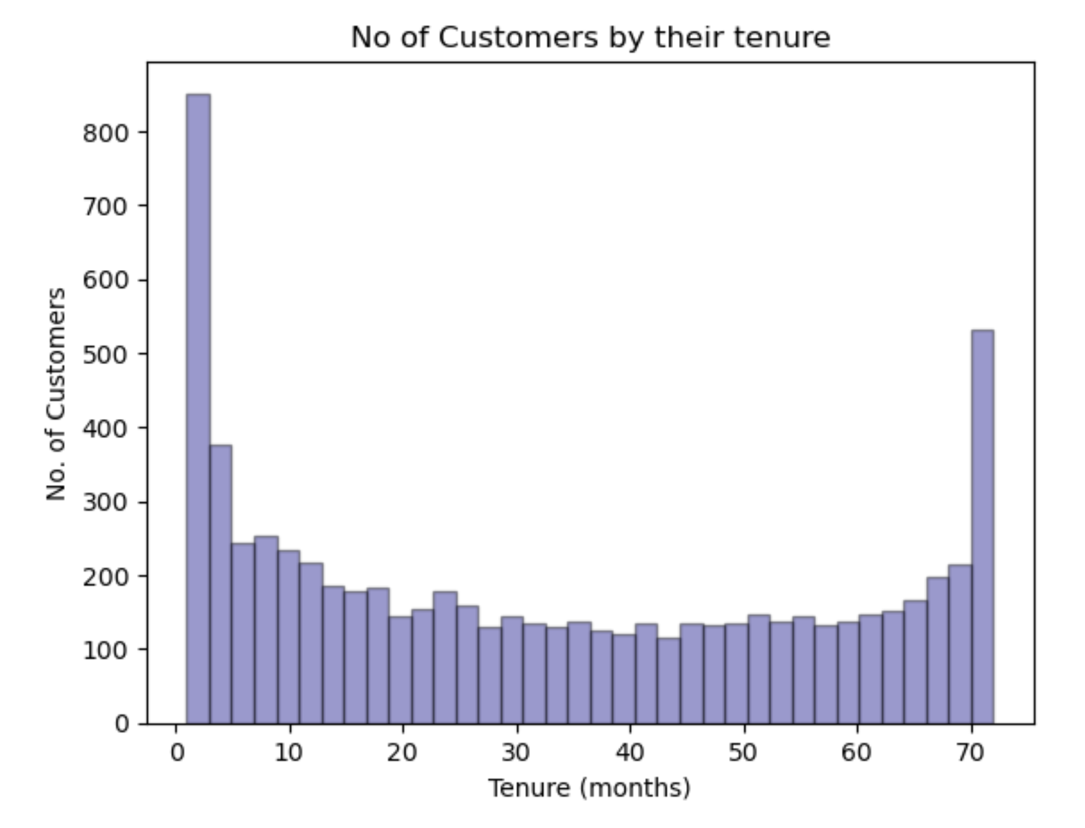
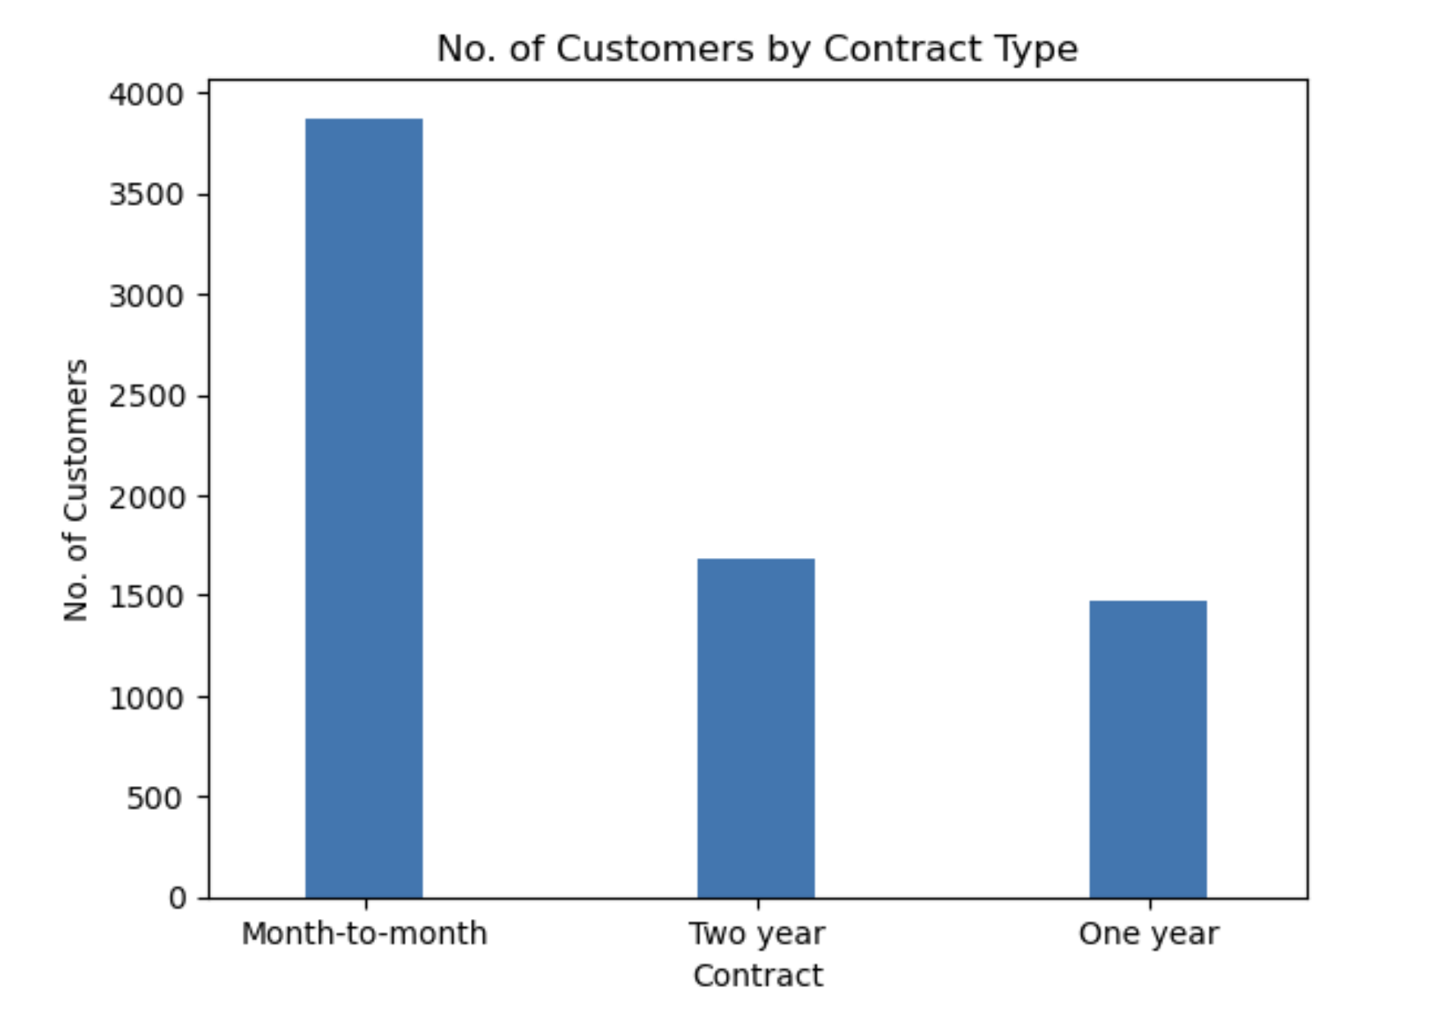
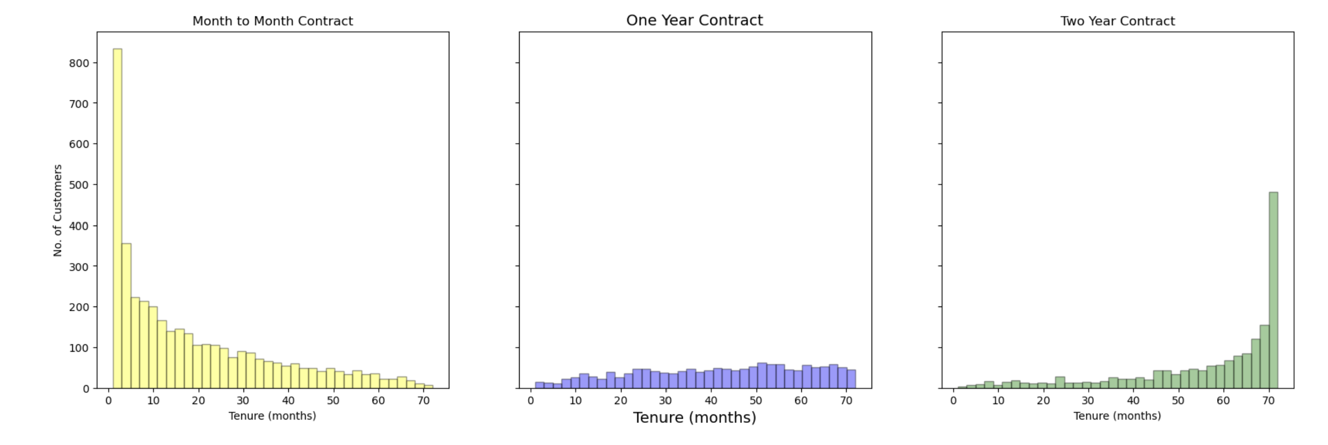
Exploratory Data Analysis (EDA)

Slide 19
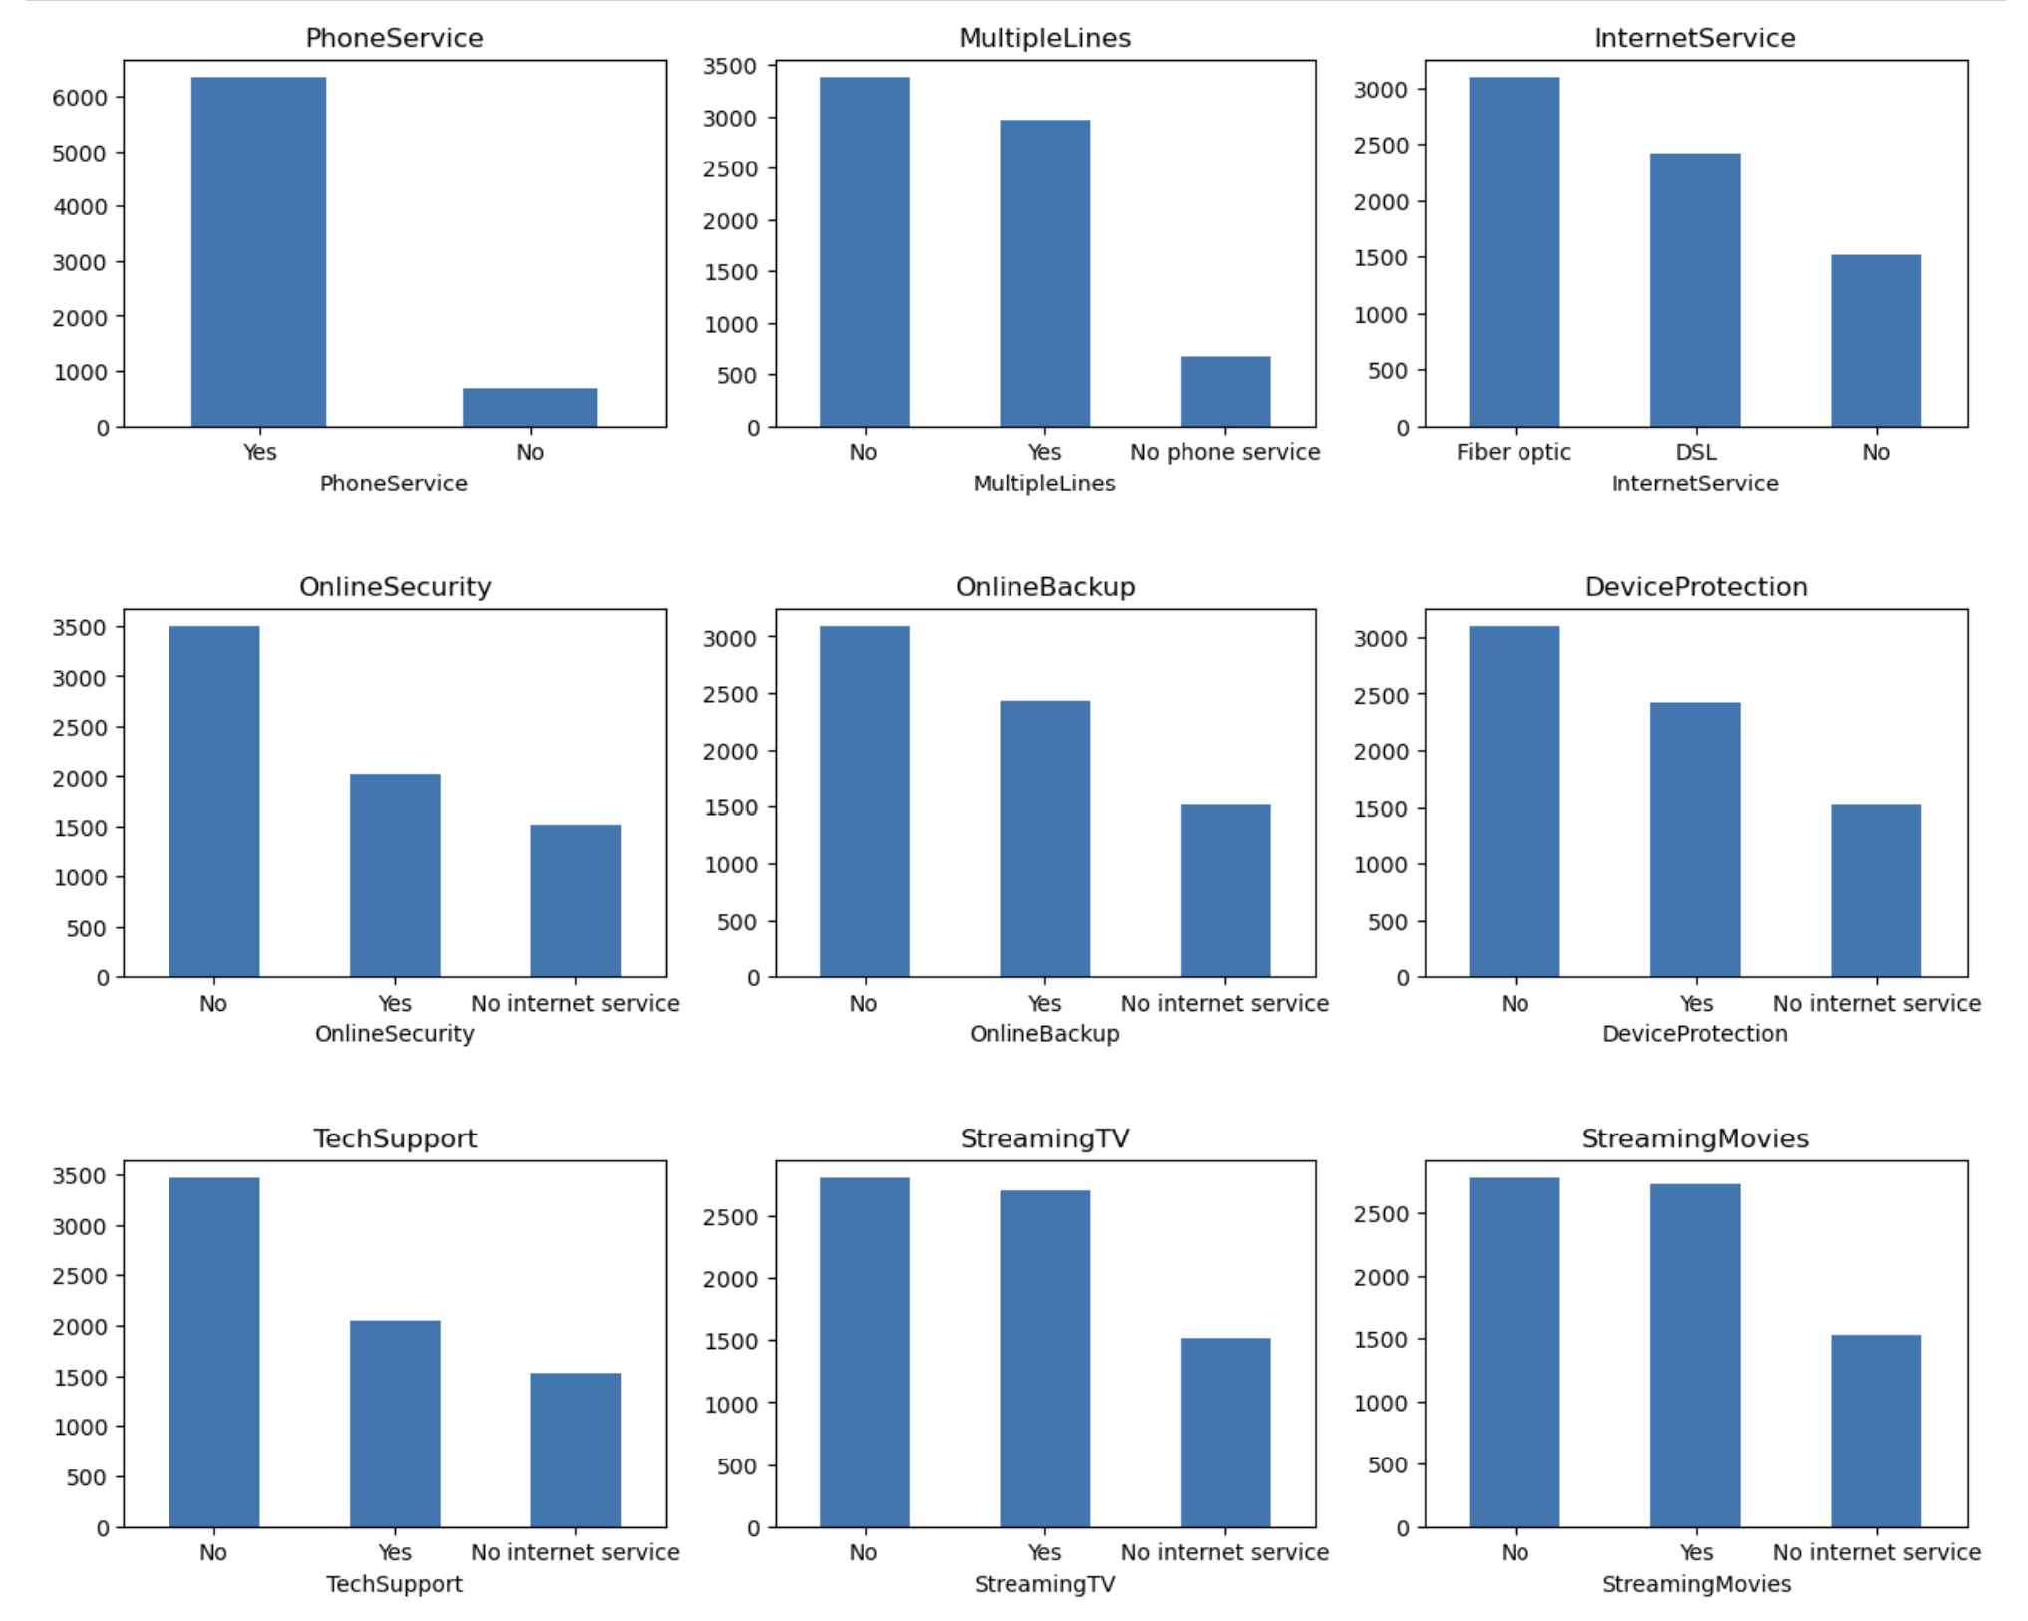
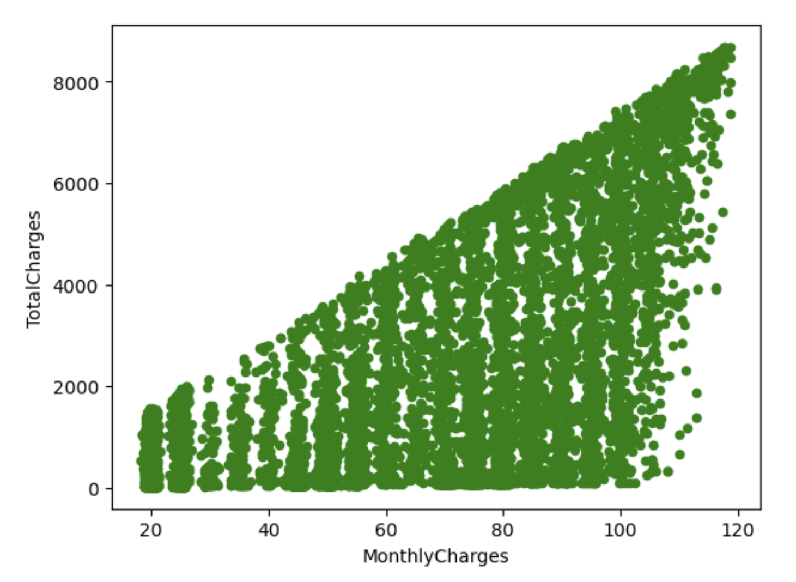
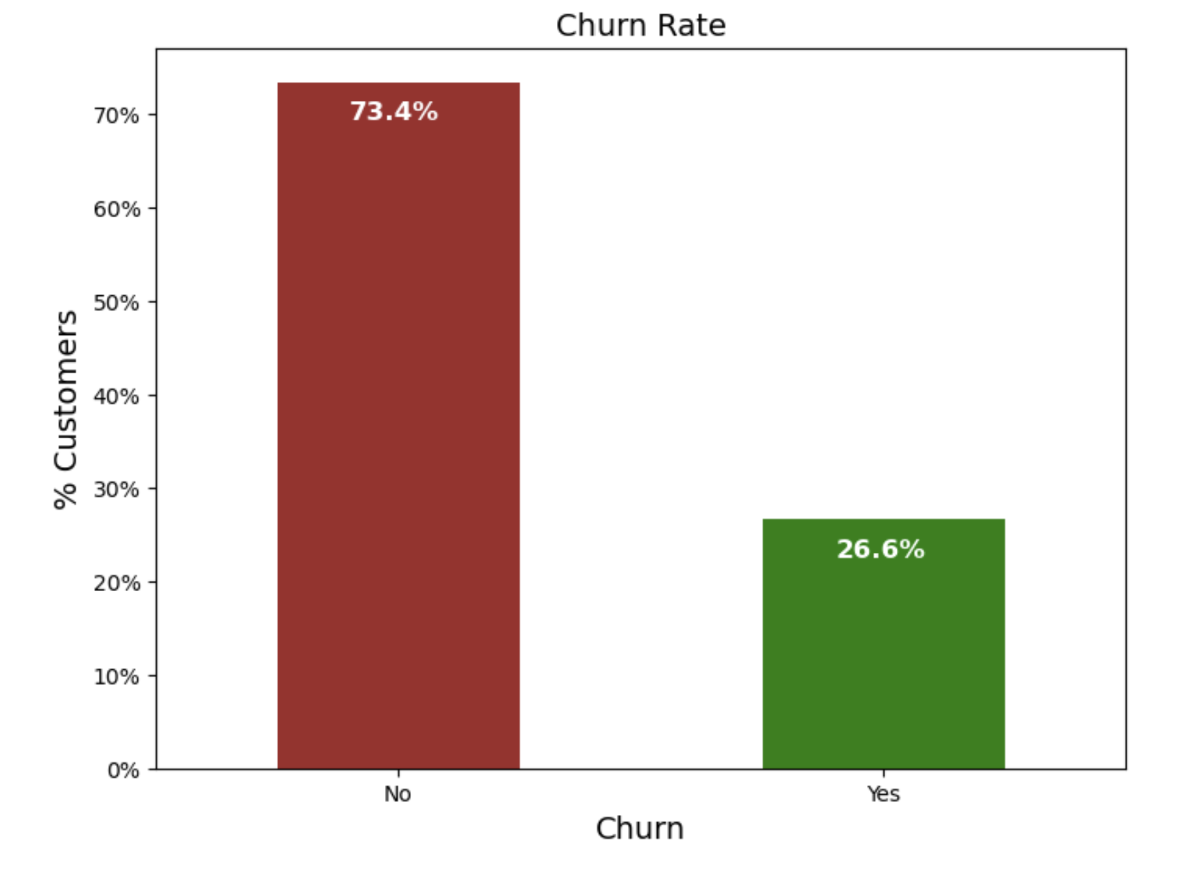
Exploratory Data Analysis (EDA)

Slide 20
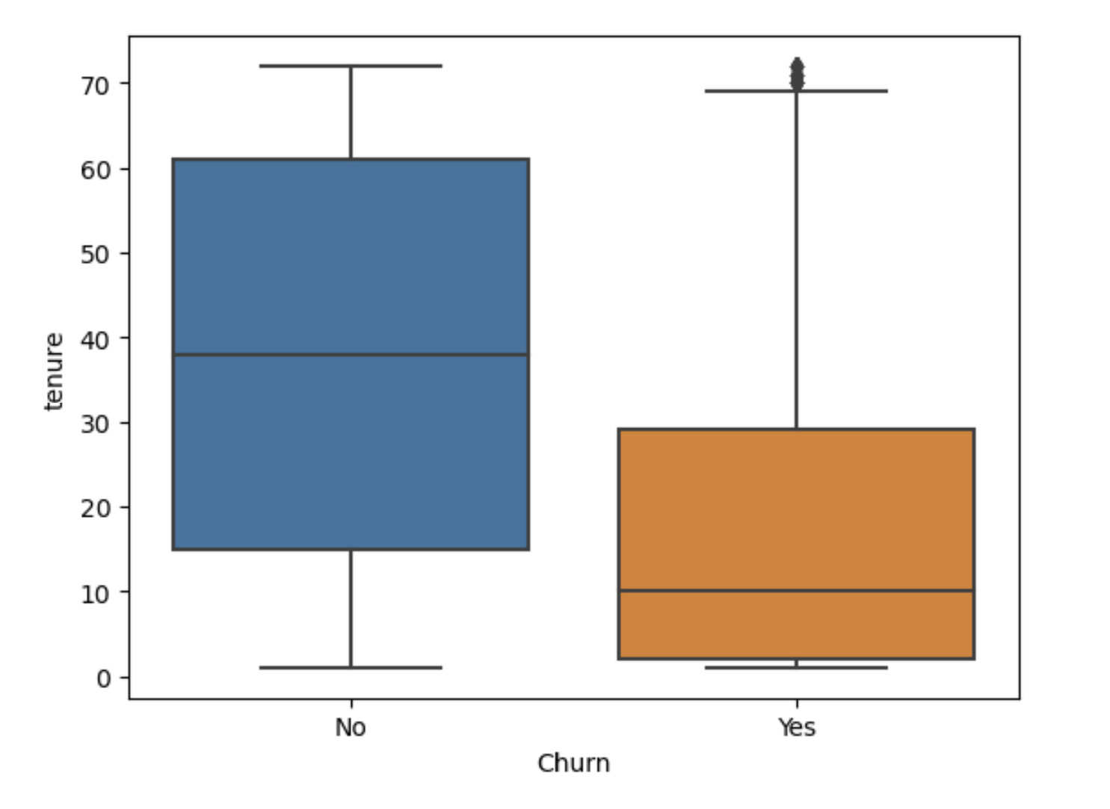
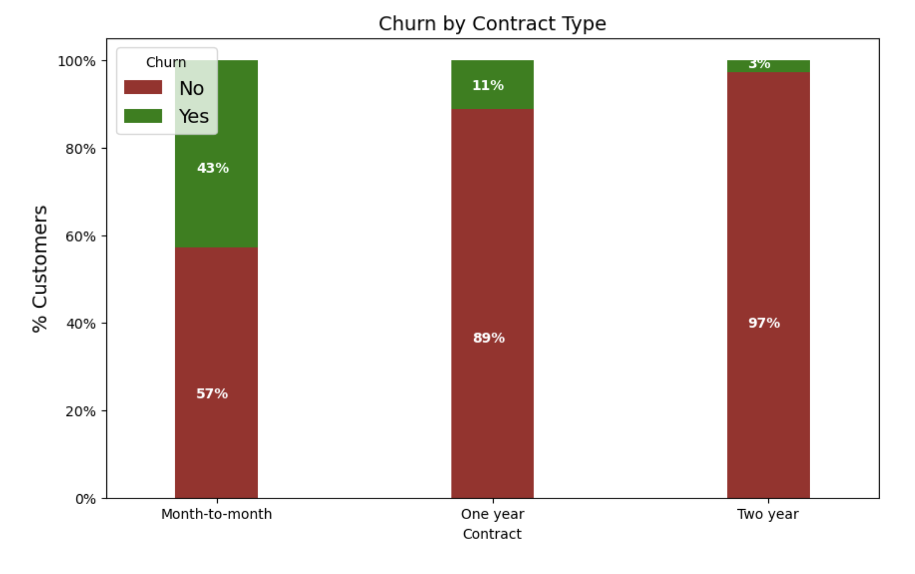
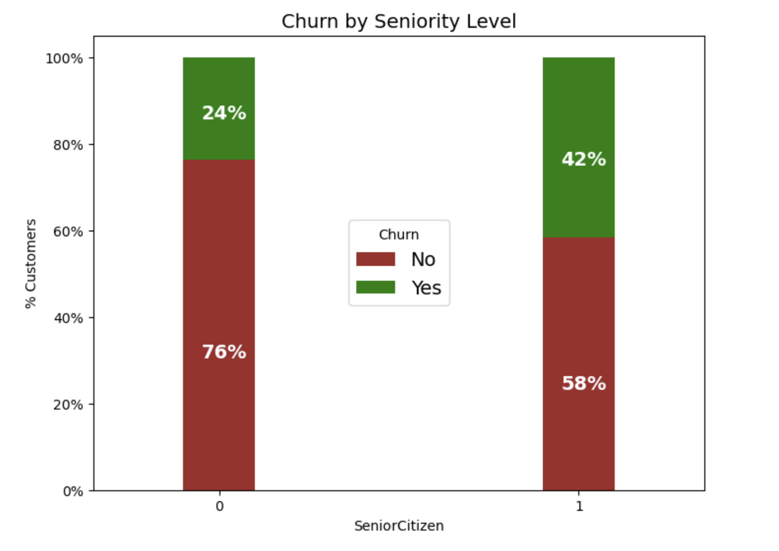
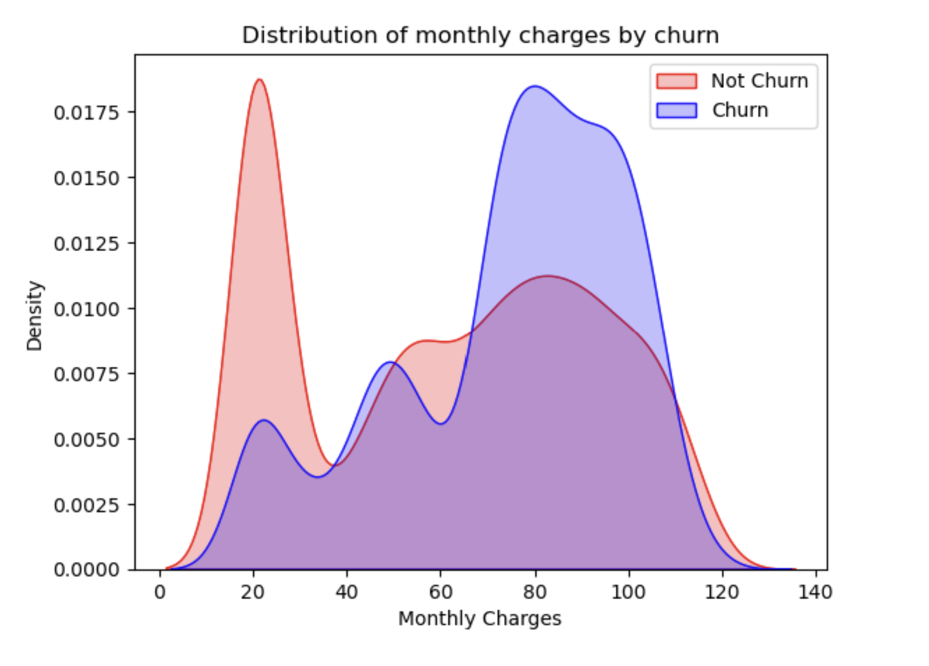
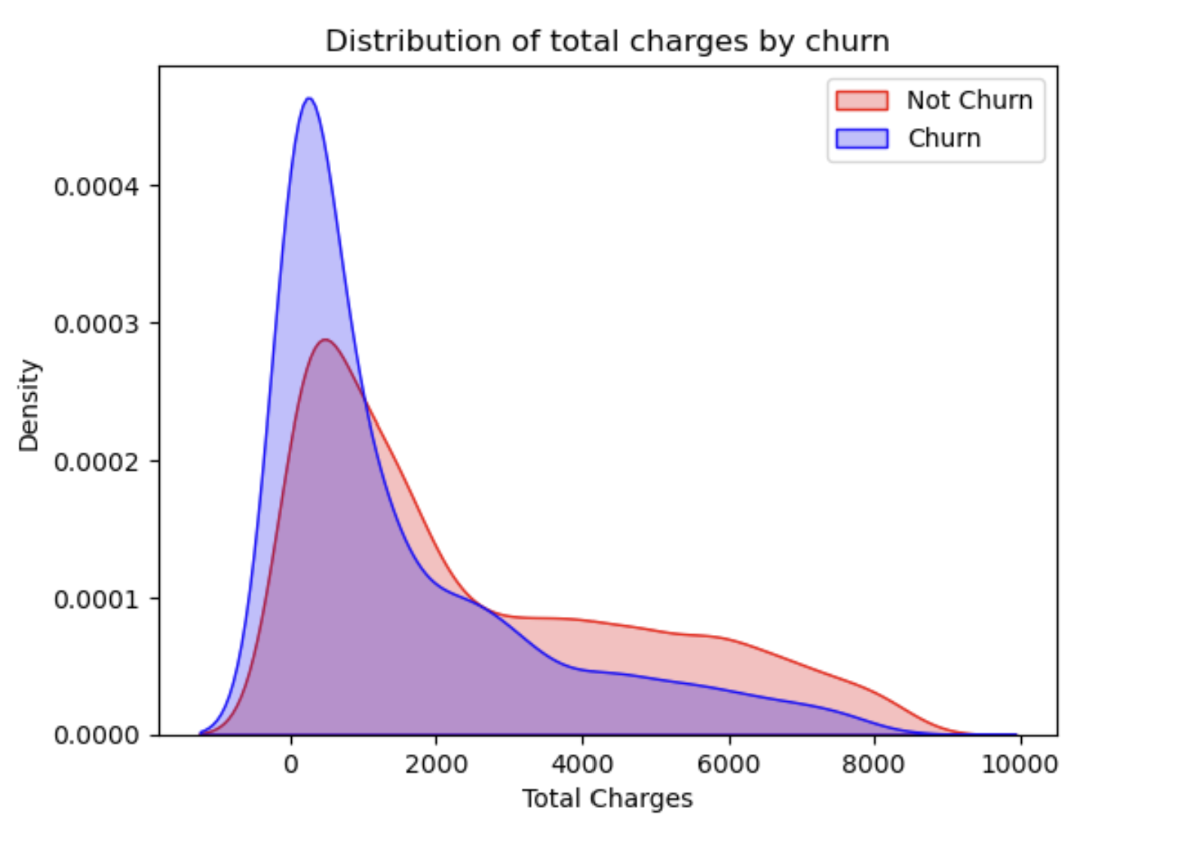
Exploratory Data Analysis (EDA)

Slide 21
Exploratory Data Analysis (EDA)
Investigated the relationship between churn and various variables such as tenure, contract type, and monthly charges.
Explored the impact of seniority on churn rates.
Analyzed the distribution of monthly and total charges concerning churn.
Key Findings:
Customers with shorter tenure, month-to-month contracts, and higher monthly charges are more likely to churn.
Senior citizens exhibit a higher churn rate compared to younger customers.
Churn is inversely related to the total charges, indicating lower churn when total charges are higher.

Slide 22
Machine Learning Model Development
Choosing a Machine Learning Algorithm: Select the right algorithm (e.g., Logistic Regression, Random Forest, SVM, Adaboost, XG Boost) for your problem.
Training and Evaluating the Model: Cover the process of training and evaluating the model to ensure its robust and reliable.
Hyperparameter Tuning: Optimize model parameters for improved performance.
Model Evaluation Metrics: Use metrics like accuracy, precision, and recall to assess how well the model is performing.

Slide 23
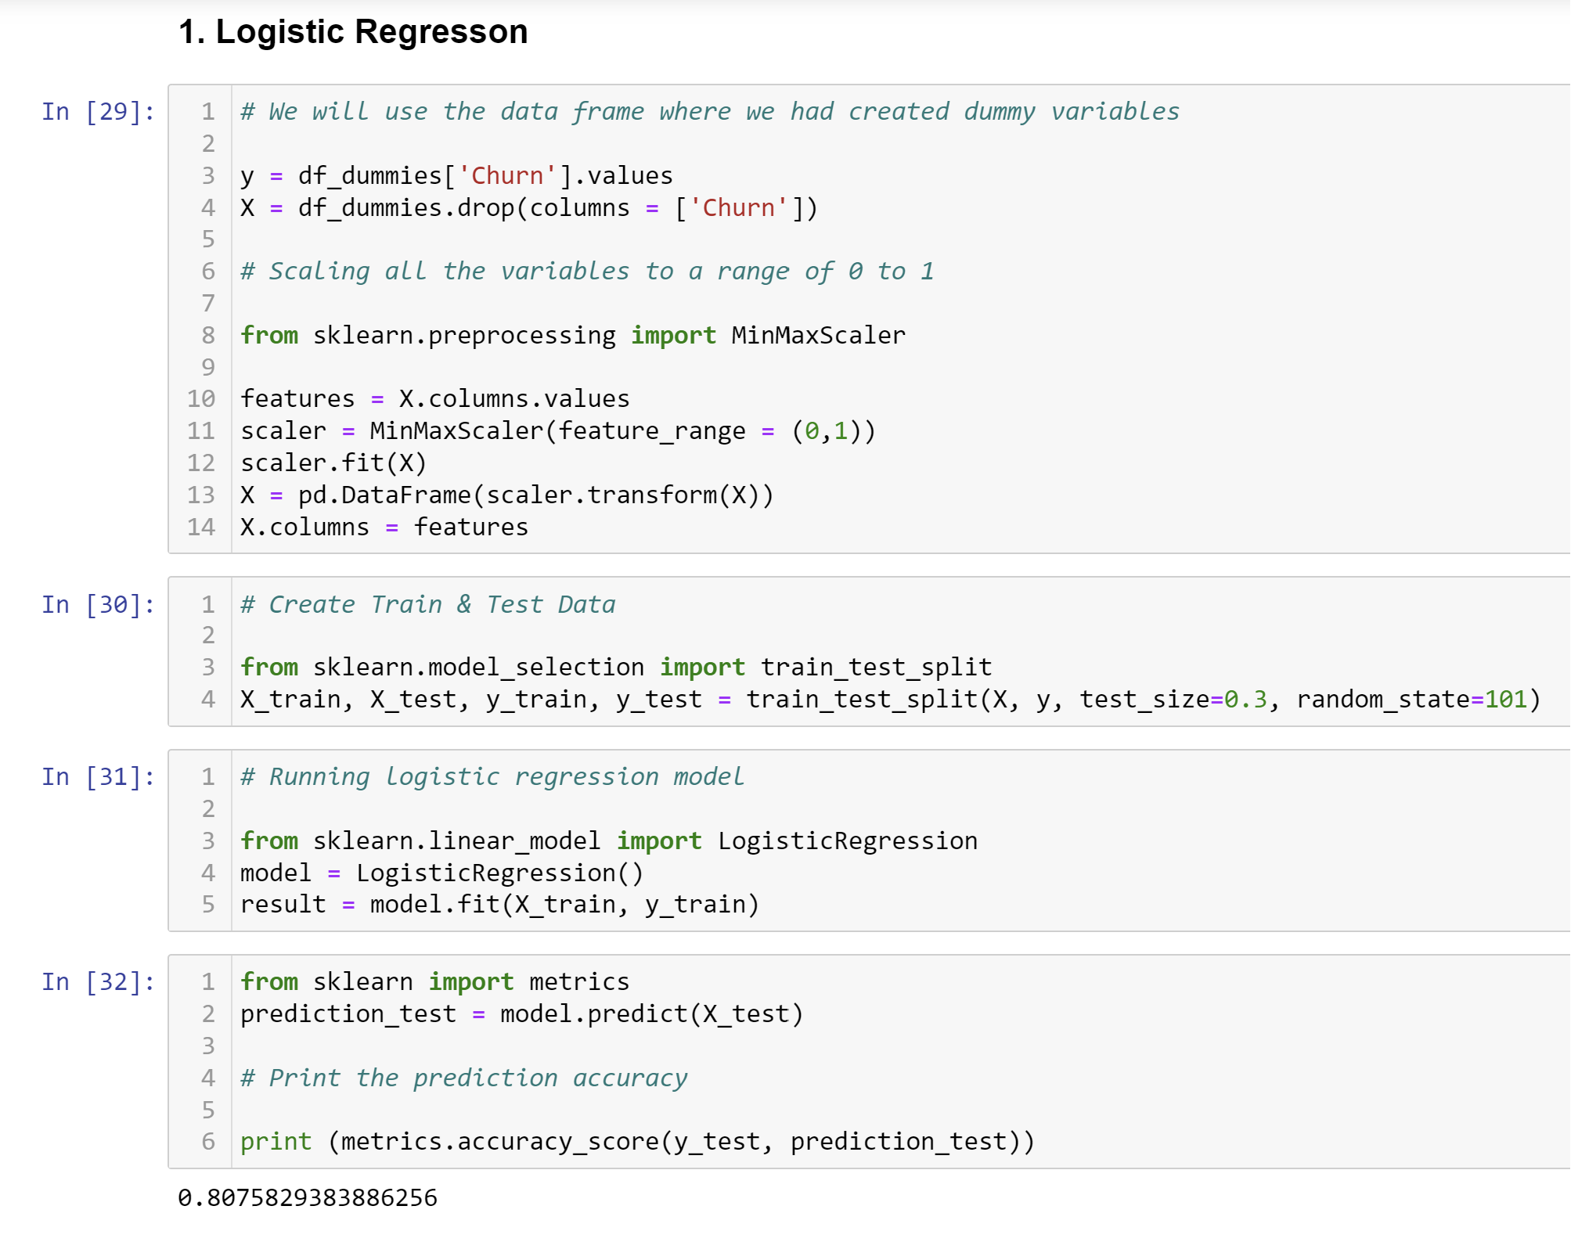
Machine Learning Model Development
Supervised Learning:
Logistic Regression:
Type: Supervised learning algorithm used for classification tasks.
Concept: It models the relationship between the dependent binary variable (target) and one or more independent variables by estimating probabilities using a logistic function. It's suitable for binary classification.

Slide 24
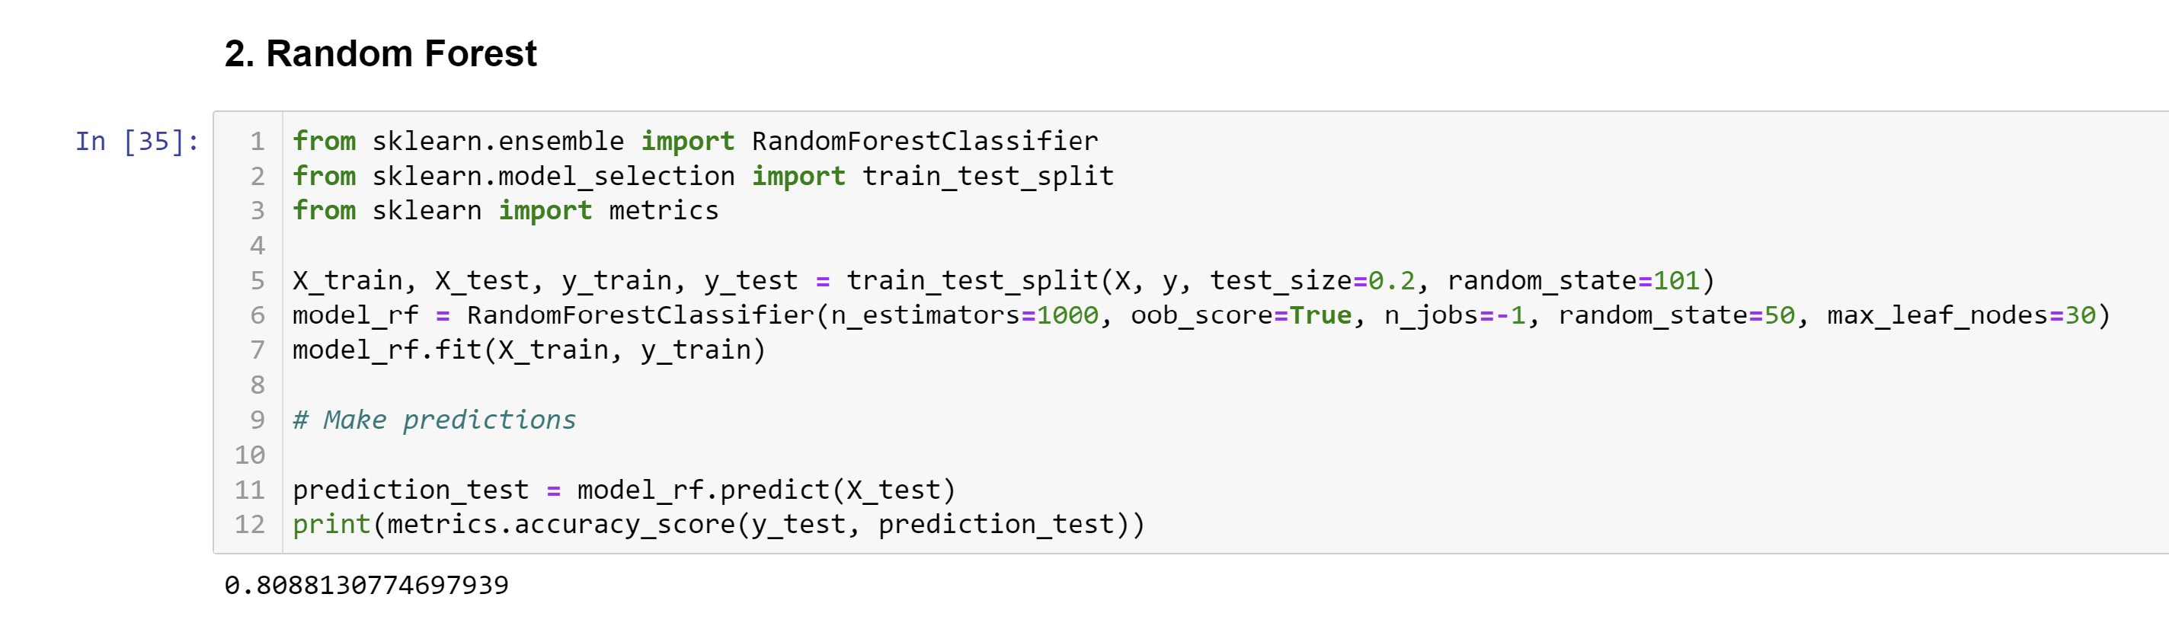
Machine Learning Model Development
2. Random Forest:
Type: Ensemble learning method, specifically a bagging algorithm.
Concept: It builds multiple decision trees and combines their predictions to produce a more accurate and robust result. Each tree in the forest is trained on a random subset of the data.

Slide 25
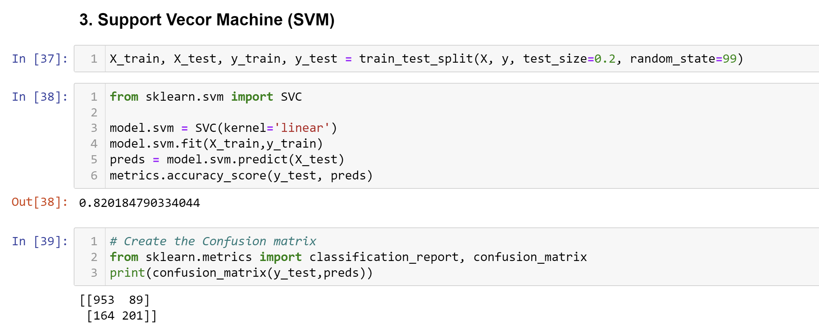
Machine Learning Model Development
3. Support Vector Machine (SVM):
Type: Supervised learning algorithm used for classification and regression tasks.
Concept: SVM finds a hyperplane that best separates data points of different classes. It aims to maximize the margin between the classes while allowing for a small number of misclassifications.

Slide 26
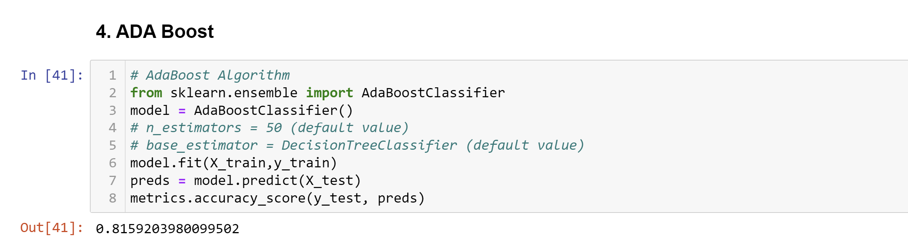
Machine Learning Model Development
4. Adaboost:
Type: Ensemble learning method, specifically a boosting algorithm.
Concept: Adaboost combines multiple weak classifiers to create a strong classifier. It assigns weights to data points, giving more importance to misclassified points, and iteratively improves the model.

Slide 27
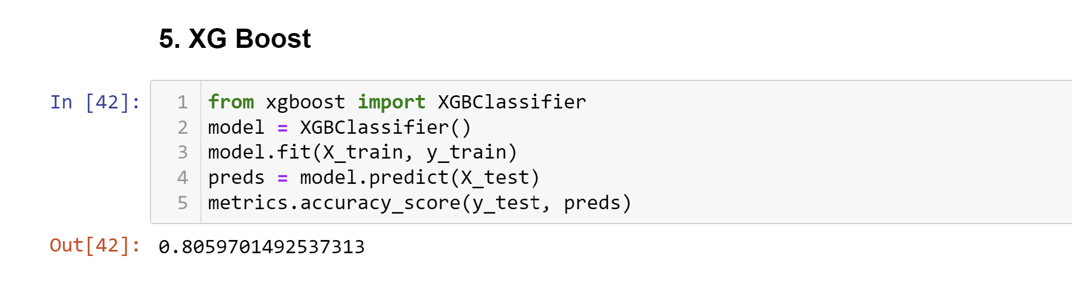
Machine Learning Model Development
5. XG Boost (Extreme Gradient Boosting):
Type: Ensemble learning method, specifically a boosting algorithm.
Concept: XG Boost is an advanced gradient boosting algorithm known for its efficiency and performance. It builds decision trees sequentially, focusing on minimizing the loss function. It uses gradient descent for optimization.

Slide 28
Machine Learning Model Development
Model Performance:
Logistic Regression: Accuracy - 80.76%
Random Forest: Accuracy - 80.88%
Support Vector Machine (SVM): Accuracy - 82.02%
ADA Boost: Accuracy - 81.59%
XG Boost: Accuracy - 80.60%
Interpretation
SVM achieved the highest accuracy, indicating its effectiveness in predicting customer churn.
Monthly contract, tenure, and total charges are identified as significant predictors of churn across multiple models.
The business should focus on retaining customers with shorter tenures, offering attractive contract terms, and managing monthly charges effectively.

Slide 29
Business Recommendations
Implement targeted retention strategies for customers with shorter tenures, such as promotional offers or discounts on long-term contracts.
Enhance customer communication and satisfaction, especially for senior citizens who exhibit a higher churn rate.
Optimize pricing strategies to maintain competitive monthly charges while emphasizing the value of services.
Consider personalized promotions for loyal customers with longer tenures to encourage them to continue with the service.
Continuously monitor and analyze customer feedback to identify areas for improvement and address customer concerns proactively.

Slide 30
Business Recommendations
Conclusion
By leveraging data science and predictive modeling, the telecom company can gain valuable insights into customer churn patterns and implement strategies to enhance customer retention.
The combination of exploratory data analysis and machine learning provides a comprehensive understanding of customer behavior, empowering the business to make informed decisions and foster long-term customer relationships.

Slide 31
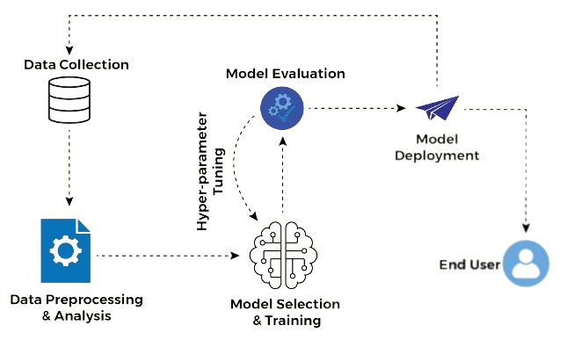
Introduction to Model Deployment
Model deployment is the process of making a trained machine learning model available for use in real-world applications.
It involves taking a model from the development and testing phase and integrating it into a production environment.

Slide 32
Introduction to Model Deployment
Importance of Deployment in Machine Learning:
Deploying a model is a crucial step in the machine learning lifecycle as it allows organizations to leverage the model's predictions for decision-making, automation, and improving processes.
Models are created for practical use, and deployment bridges the gap between model development and real-world impact.

Slide 33
Introduction to Model Deployment
Challenges in Model Deployment:
Scalability: Deploying a model that can handle a large number of requests efficiently can be challenging.
Data Drift: Real-world data often changes over time, and deployed models need mechanisms to adapt to this data drift.
Security: Ensuring that the deployed model is secure and not vulnerable to attacks or misuse is critical.
Monitoring and Maintenance: Continuous monitoring and maintenance are required to keep deployed models performing at their best.

Slide 34
Setting Up a Deployment Environment
Install Anaconda
Open Anaconda Navigator
Launch Anaconda Navigator, which provides a graphical user interface to manage your Python environments and packages.
Create a New Environment:
In Anaconda Navigator, go to the "Environments" tab and create a new environment for your deployment project. You can do this by clicking the "Create" button.

Slide 35
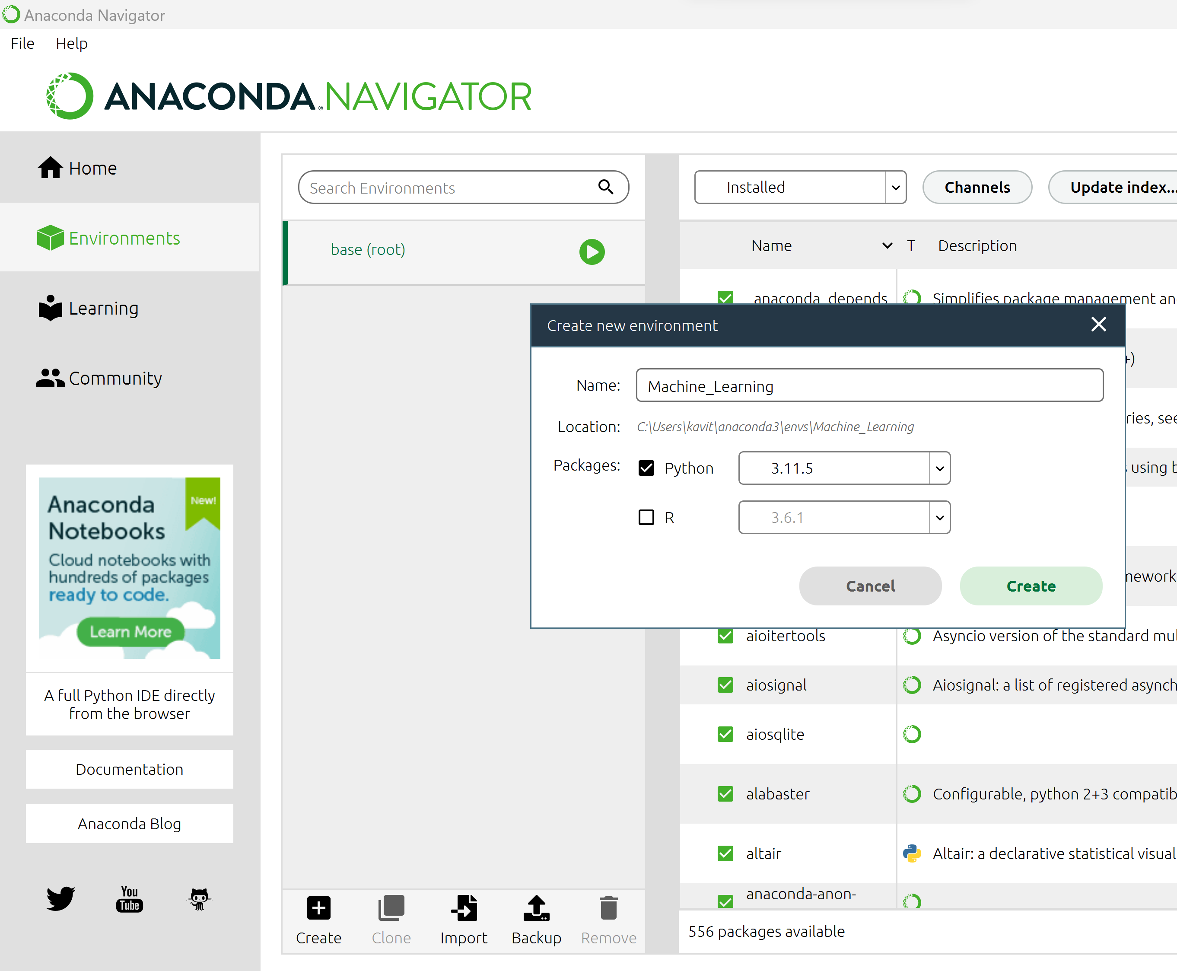
Setting Up a Deployment Environment
Streamlit currently supports versions 3.8, 3.9, 3.10, and 3.11 of Python (Step 4).
1
3
4
2

Slide 36
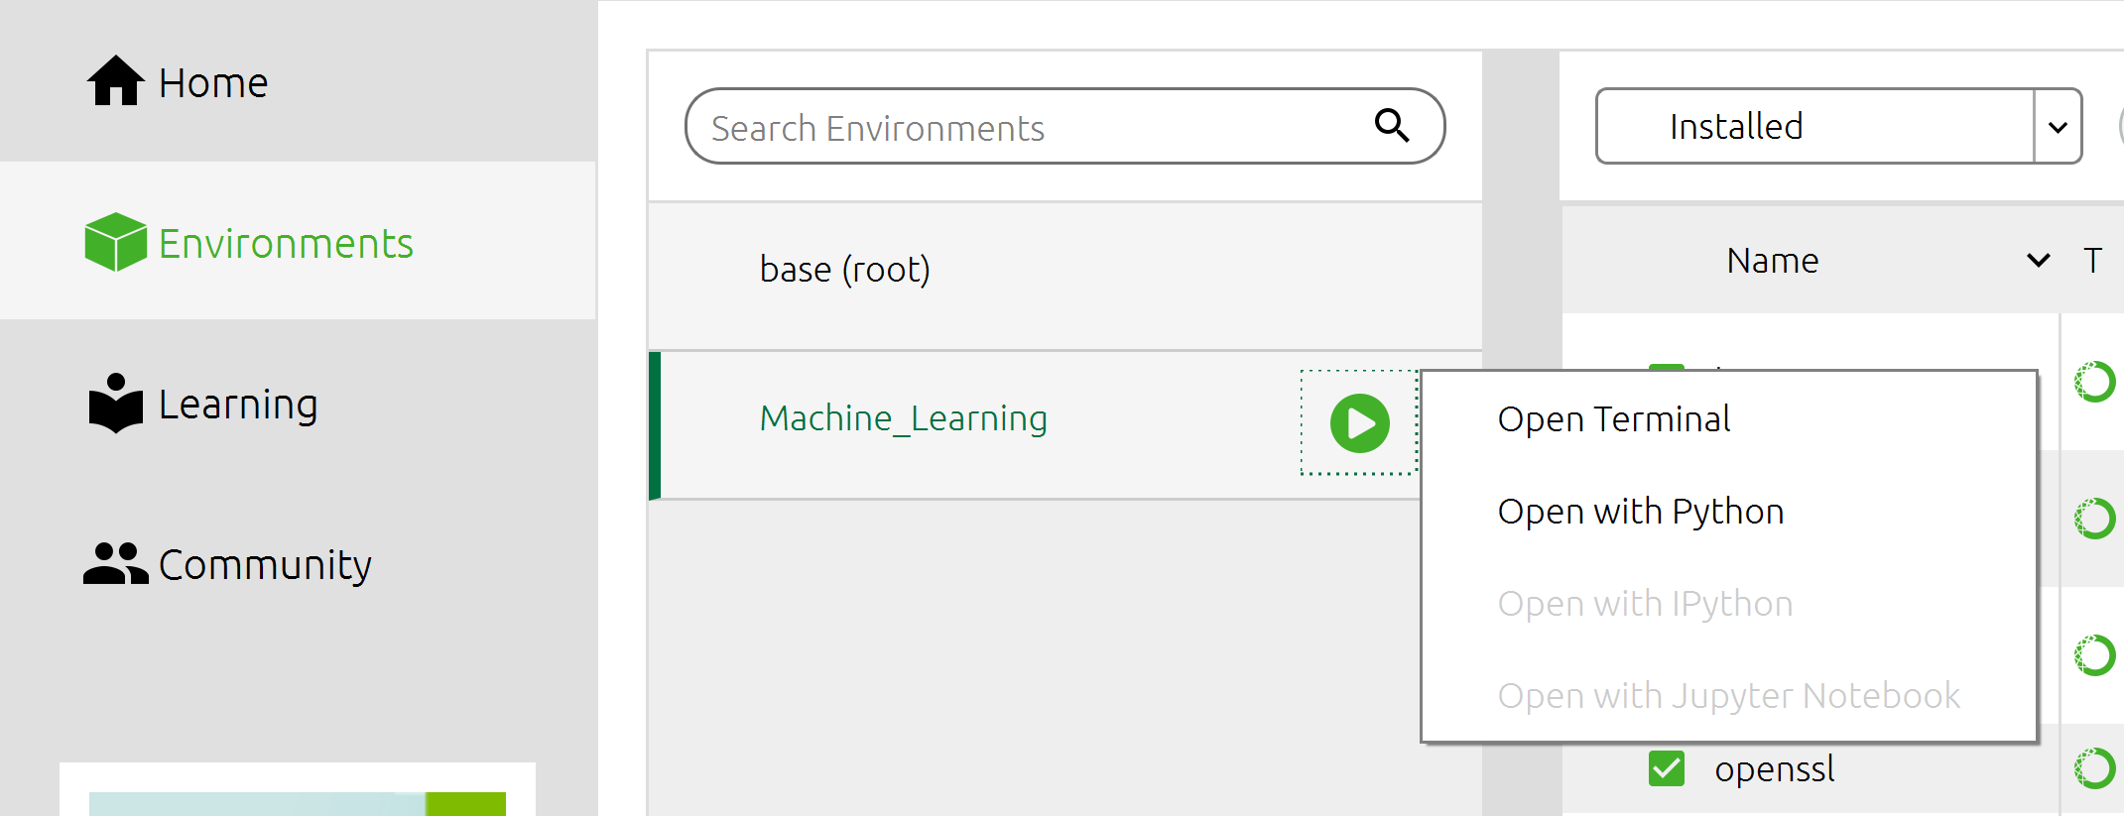
Setting Up a Deployment Environment
Install Spyder:
In the created environment, you can install Spyder, a powerful integrated development environment (IDE) for Python, using Anaconda Navigator or by running the following command in Anaconda Prompt:
conda install spyder
Install Streamlit:
Install Streamlit in your environment. Streamlit is a Python library for creating web applications for data science and machine learning. You can install it using pip by running:
pip install streamlit

Slide 37
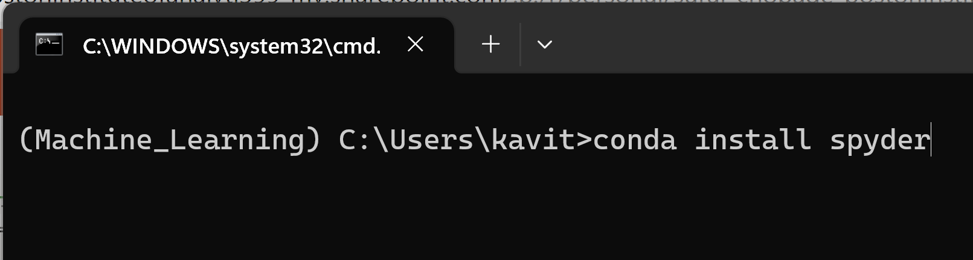
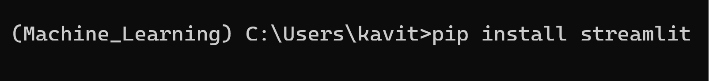
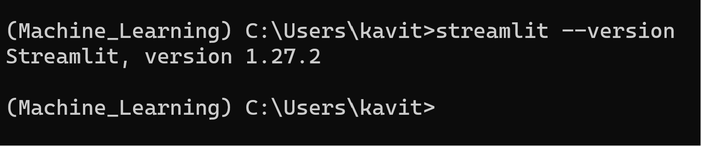
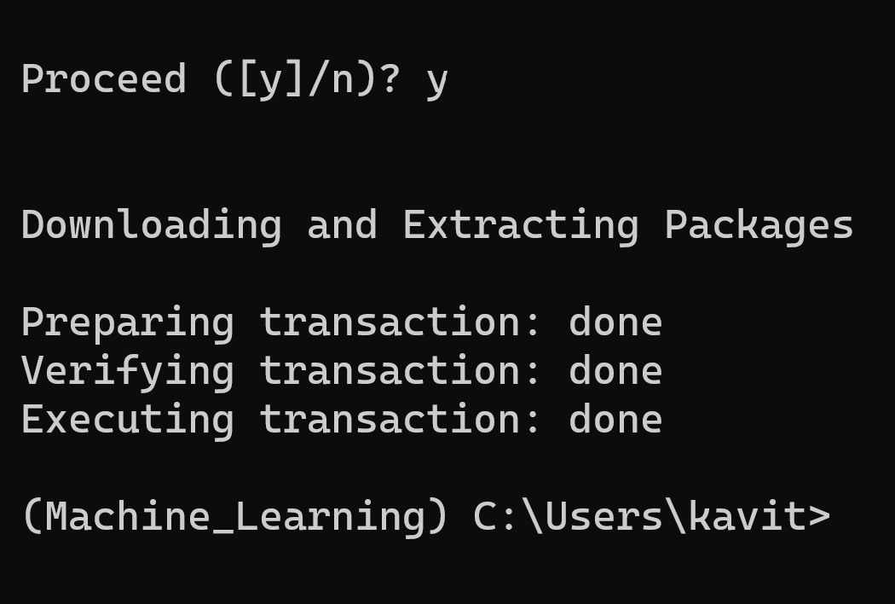
Setting Up a Deployment Environment
To install Spyder IDE
To install Streamlit

Slide 38


Setting Up a Deployment Environment
Streamlit:
Open-source Python library for creating web apps.
Ideal for data scientists to quickly build interactive apps.
Transforms data scripts into shareable web apps.
Used for dashboards, visualizations, and ML model interfaces.
Simplifies web-based UI development in Python.
Spyder:
Integrated Development Environment (IDE).
Tailored for data science, scientific, and engineering projects.
Features code editing, variable explorer, and debugging.
Supports data analysis libraries (NumPy, SciPy, pandas).
Used for writing, testing, and debugging Python code.
Ideal for data analysis and scientific computing tasks.

Slide 39
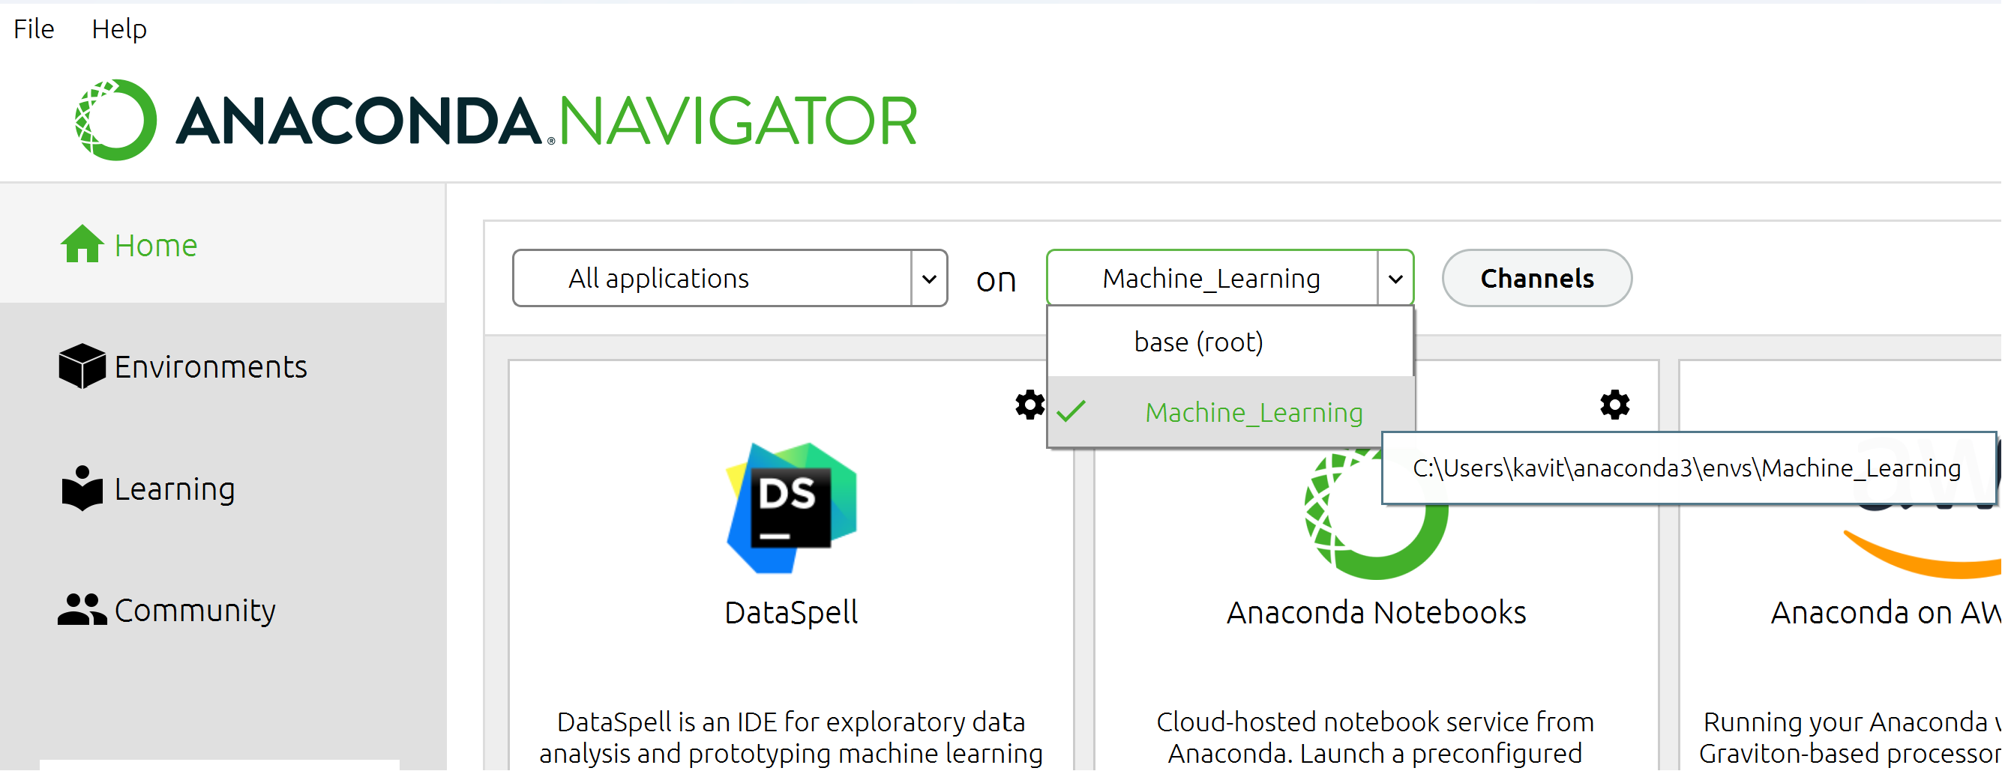
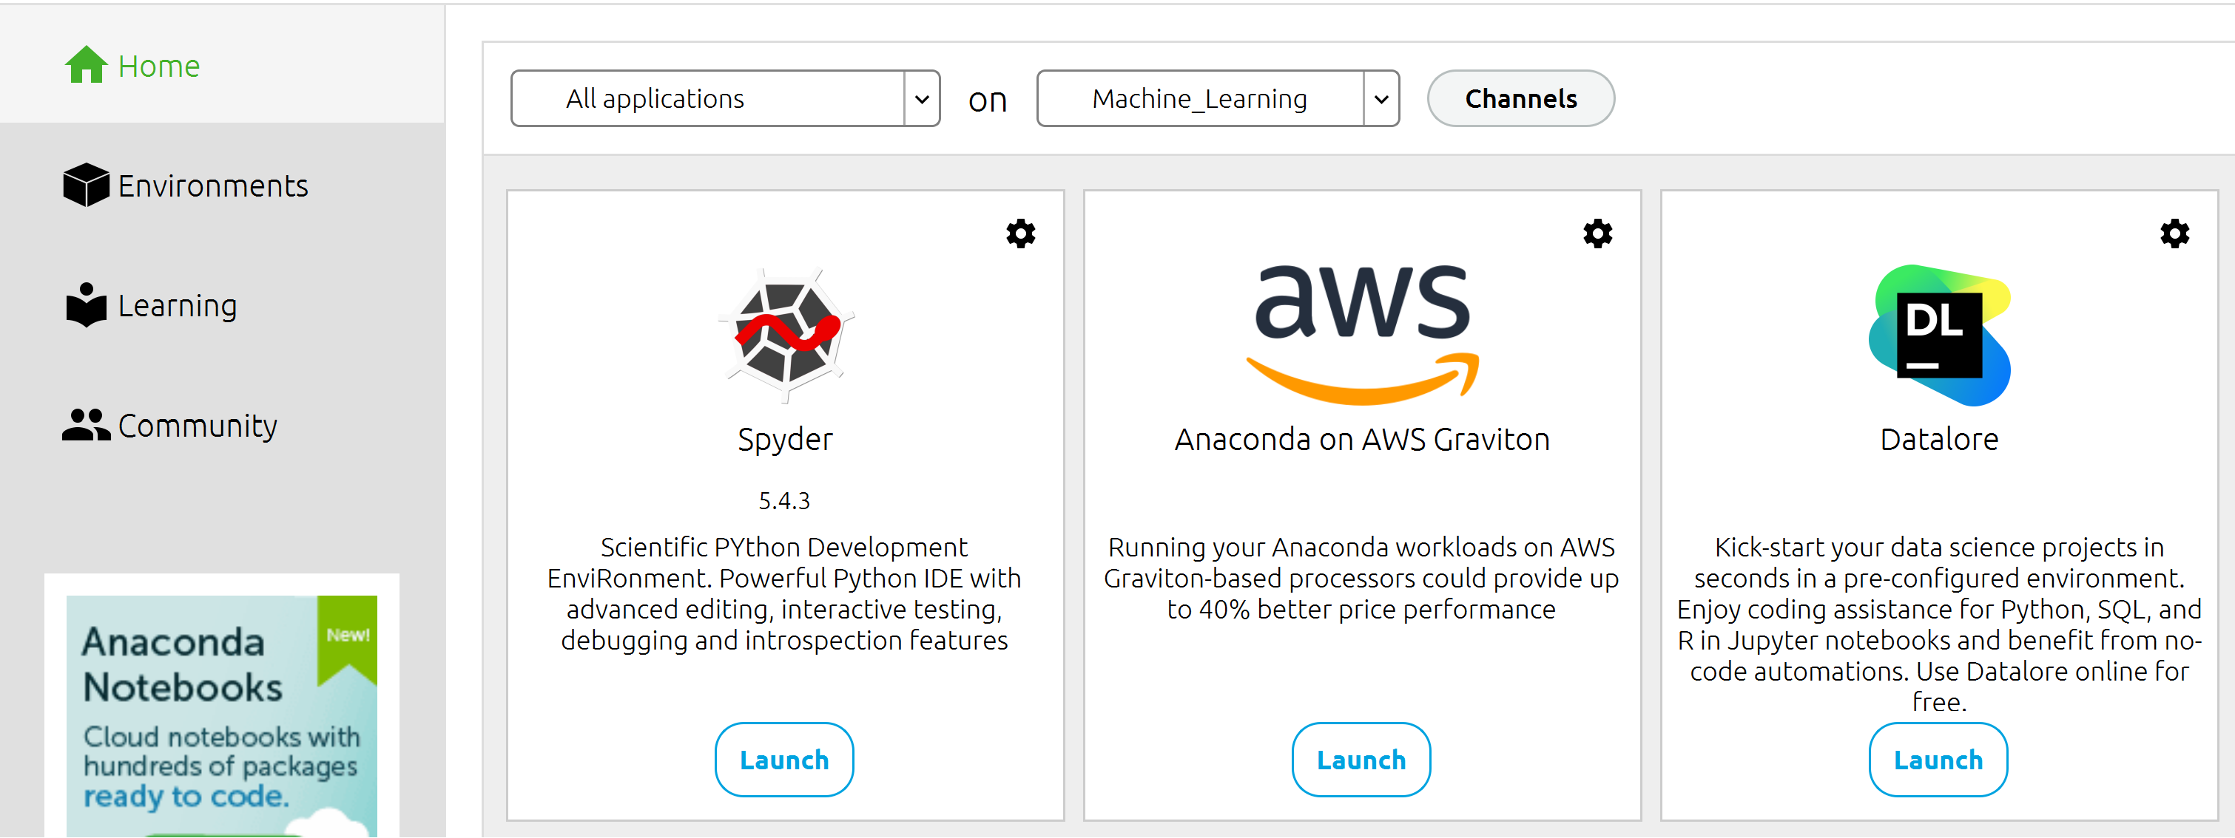
Launching Spyder

Slide 40
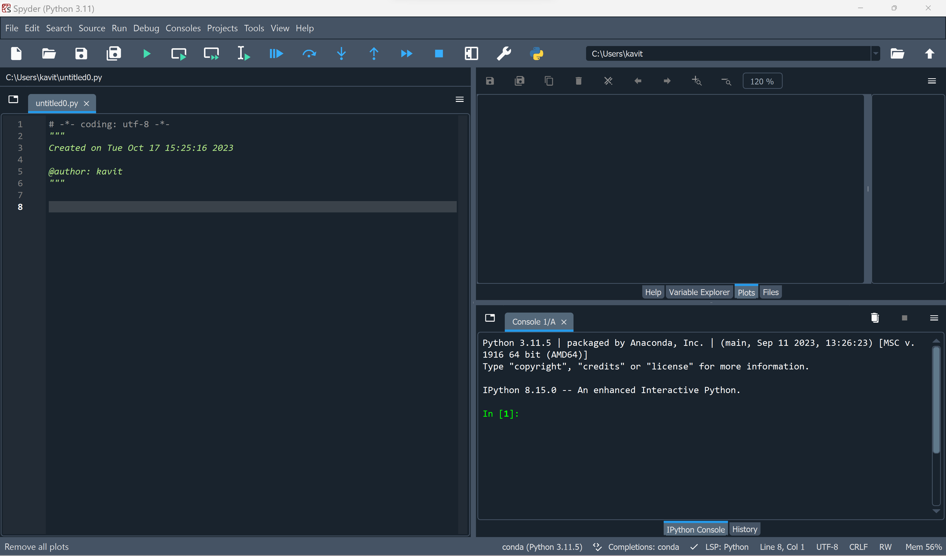
Launching Spyder

Slide 41
Streamlit
Install Streamlit: Use pip install streamlit to install Streamlit.
Create Python Script: Write your Python script.
Add Streamlit Code: Import Streamlit (import streamlit as st) and use Streamlit commands to design your app.
Run the App: In the terminal, use streamlit run your_script.py to start your Streamlit app.
Access Locally: Streamlit opens the app in a web browser for local access.
Make Changes: Save script changes, and Streamlit will auto-reload the app.
Sharing: Deploy the app or share it with others.

Slide 42
Model Deployment
Importance of Model Deployment:
Actionable Insights: Deployment makes data science results practical and actionable.
Bridges the Gap: It connects model development to real-world use.
Real-Time Decision-Making: Deployed models drive real-time decisions and automation.
Business Efficiency: Deployment turns data science into a valuable asset for business.
Transforms Data into Value: It transforms data analysis into tangible value.

Slide 43
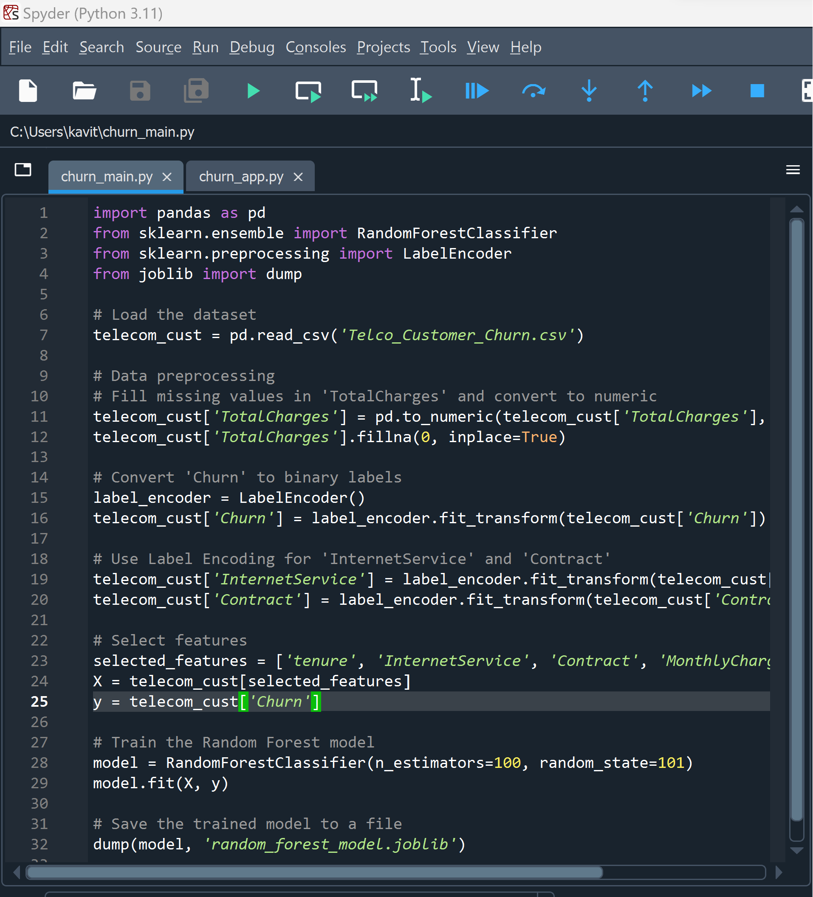
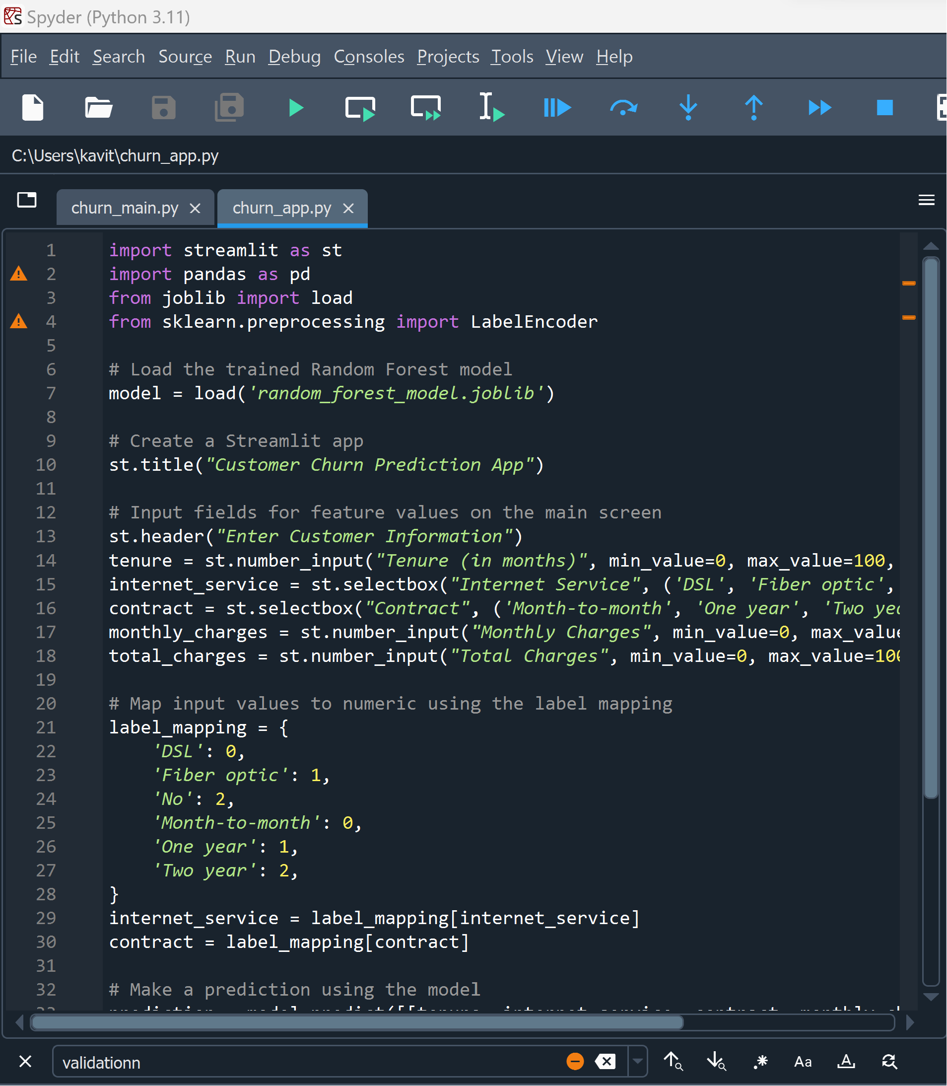
Model Deployment
Telco Customer Churn ML Model file – churn_main.py
Streamlit Web App file – churn_app.py

Slide 44
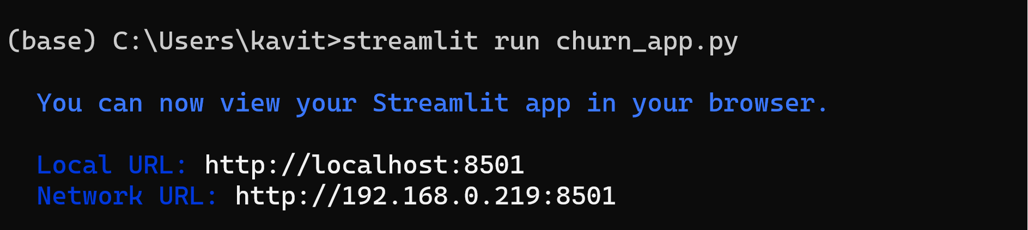
Model Deployment
Running churn_app.py File in same environment where Telco_Customer_Churn.csv (dataset), churn_main.py and Spyder is present
Streamlit run churn_app.py

Slide 45
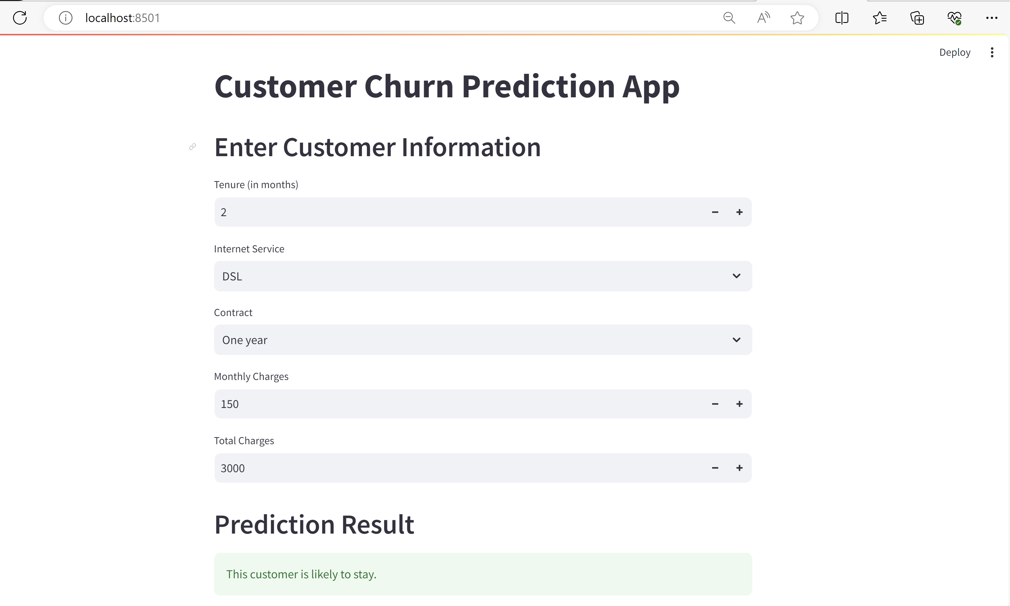
Model Deployment
Streamlit web app for Customer Churn Prediction App
App Name
2. User Input
3. Output

Slide 46
Questions ?

Slide 47
Thank You !

